Slide 1

Low-temperature STM and transport studies on superconductor-graphene junctions
Zoltán OSVÁTH
Institute of Technical Physics and Materials Science (MFA)
Research Centre for Natural Sciences,
Hungarian Academy of Sciences (MTA TTK)
© Copyright 2013. All requests should be sent to: osvath.zoltan@ttk.mta.hu.

Slide 2





1. Low-temperature STM investigation of contacted exfoliated graphene
Zoltán Osváth, Claude Chapelier, and François Lefloch
CEA Grenoble, Institute for Nanoscience and Cryogenics (INAC)
(2008 – 2010)
2. Electric transport measurements on
superconductor-graphene-superconductor (SGS) junctions
Zoltán Osváth, Adrien Allain, Zheng Han, and Vincent Bouchiat
CNRS / NÉEL Institute, Grenoble
(2010 – 2012)
© Copyright 2013. All requests should be sent to: osvath.zoltan@ttk.mta.hu.

Slide 3
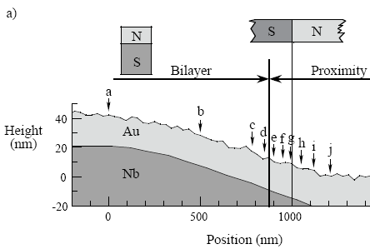
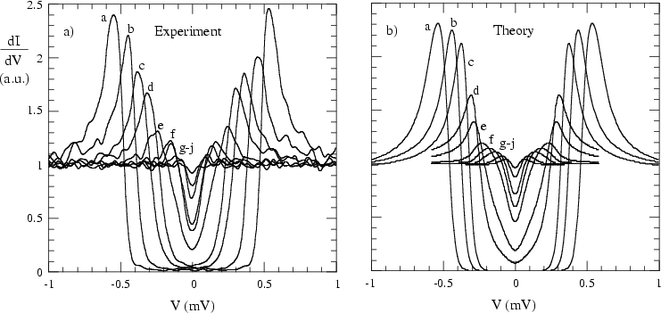

1. Low-temperature STM investigation of contacted exfoliated graphene
Zoltán Osváth, Claude Chapelier, and François Lefloch
CEA Grenoble, Institute for Nanoscience and Cryogenics (INAC)
Goal: study superconducting proximity effect in graphene
Superconducting proximity effect:
L ~ ξ_{T} (thermal coherence length)

Slide 4
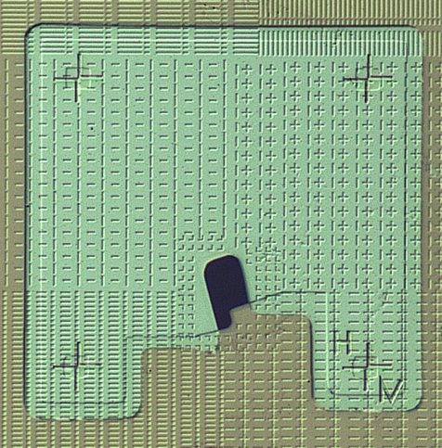
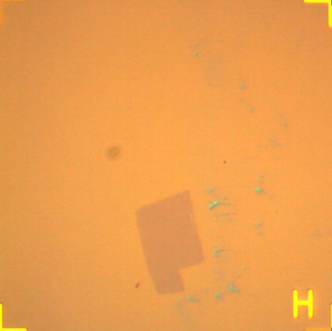
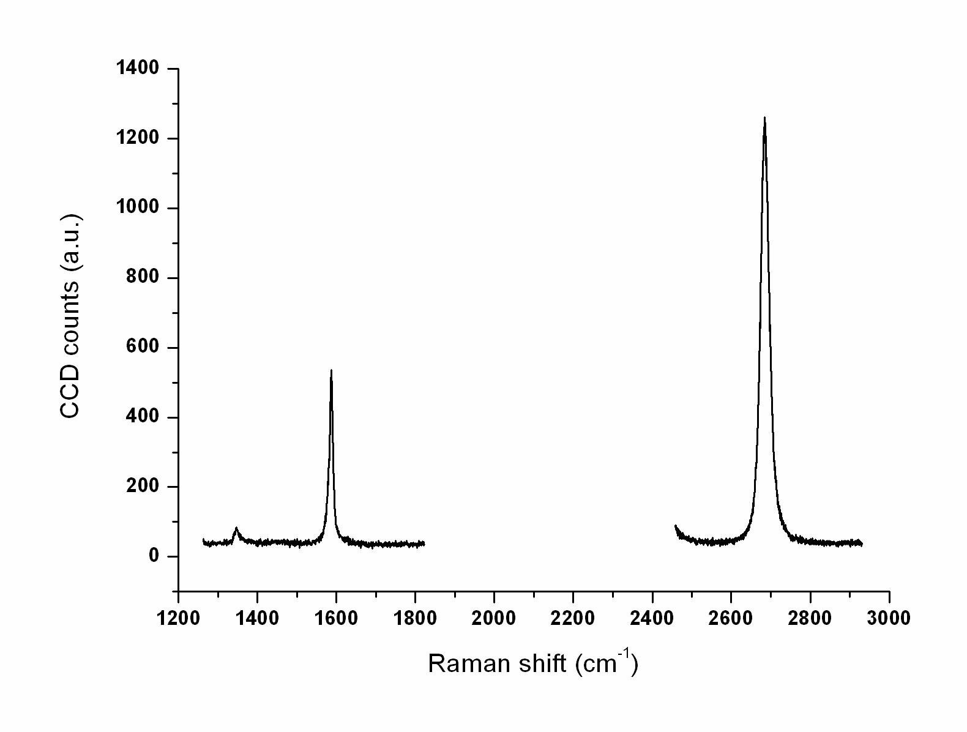
Goal: study superconducting proximity effect in graphene
Ti/Nb/Au
Ti/Nb/Au (5/40/10 nm) is deposited in a last lithographic step (PTA)
(PMMA 4%, D = 260 µC/cm², I = 50 pA )
SiO₂
e-beam lithography
gr
© Copyright 2013. All requests should be sent to: osvath.zoltan@ttk.mta.hu.

Slide 5
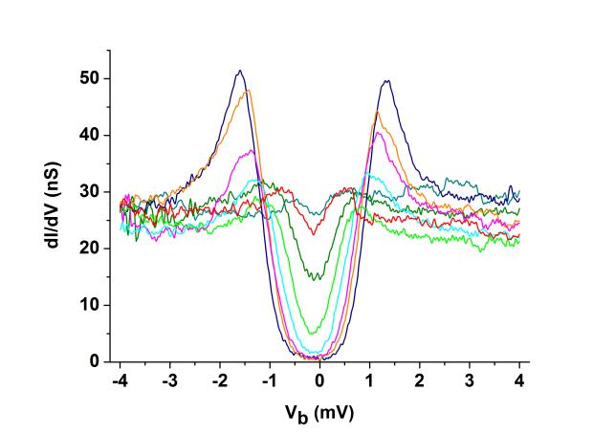
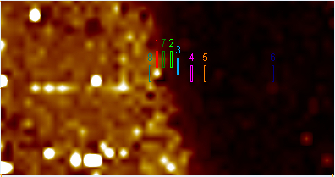
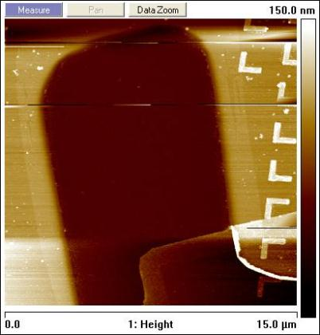
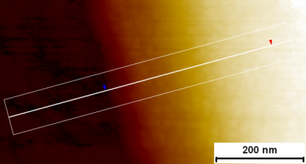
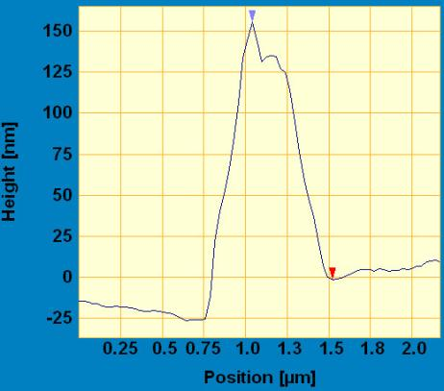
© Copyright 2013. All requests should be sent to: osvath.zoltan@ttk.mta.hu.
double layer e-beam lithography to improve the metal edge profile:
two PMMA-s with different sensitivities
> 350-400 nm of undercut, smooth edge profile
no ultrasounds for lift-off
dI/dV map at E_{F}
50
nS
0
STM image (RT)
Ti/
Nb/
Au
PMMA 2%
PMMA 4%
AFM image @ RT
(15x15 µm²)
lift-off :
STM image @ 1.6 K

Slide 6
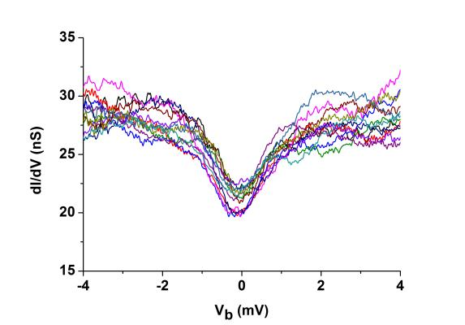
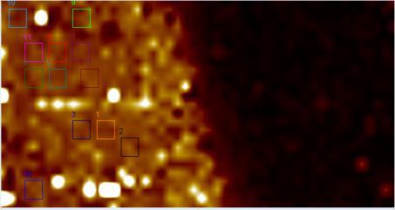
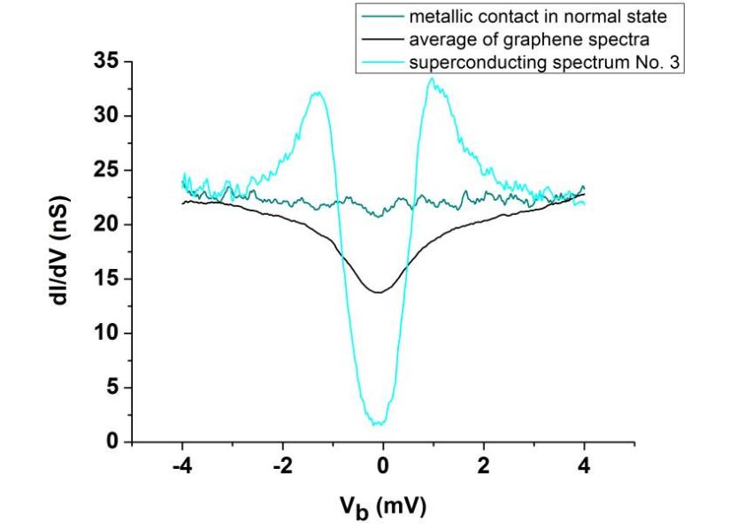
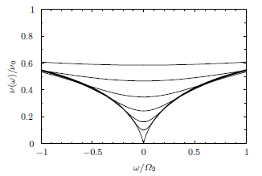
© Copyright 2013. All requests should be sent to: osvath.zoltan@ttk.mta.hu.
dI/dV map at E_{F} :
690x360 nm²
50
nS
0

Slide 7
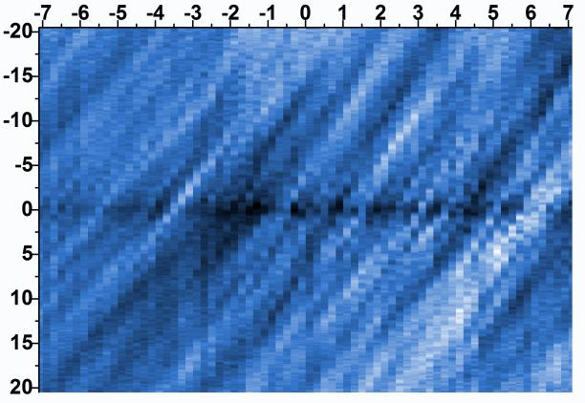
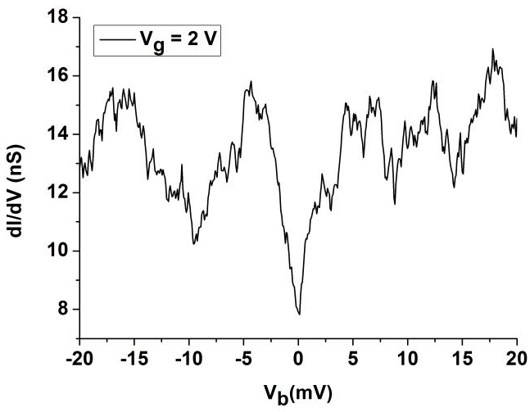
© Copyright 2013. All requests should be sent to: osvath.zoltan@ttk.mta.hu.
Back-gate voltage dependence of the spectra:
V_{g} (V)
V_{bias} (mV)
Spectra at a fixed distance (~150 nm ) from the contact
E_{C} = e²/C_{tot} = eΔV_{bias} , E_{C} = 3.4 – 11 meV
C_{g} = C_{tot} ∙ (ΔV_{bias}/ ΔV_{g})
C_{g} = εA/d, d ≈ 300 nm
D = 30 – 54 nm
S. Jung, et al., Nature Phys. 7 (2011) 245

Slide 8
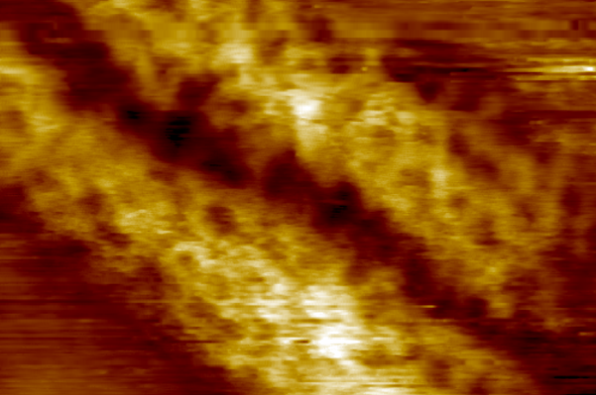
© Copyright 2013. All requests should be sent to: osvath.zoltan@ttk.mta.hu.
Large extrinsic rippling near the contact creates suspended areas:
350×210 nm²
50×32 nm²
85x85 nm² (V_{bias} = -1 V, I = 500 pA)
STM @ 1.5 K

Slide 9
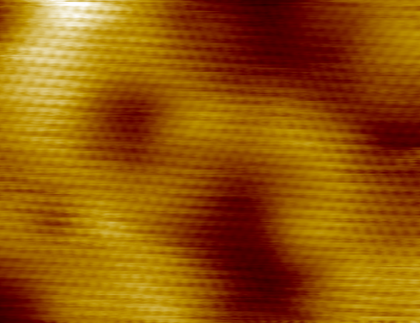
Intrinsic rippling on the suspended areas:
18×12 nm²
8.5×6.5 nm²
4.5×4.5 nm²
© Copyright 2013. All requests should be sent to: osvath.zoltan@ttk.mta.hu.
STM @ 1.5 K

Slide 10
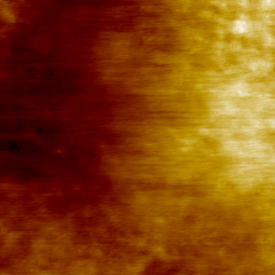
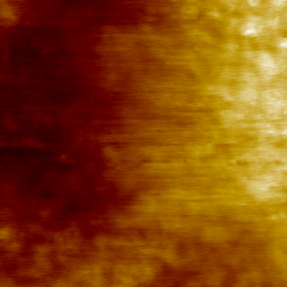
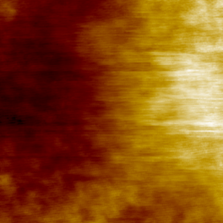
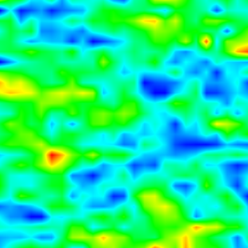
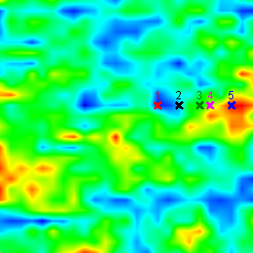
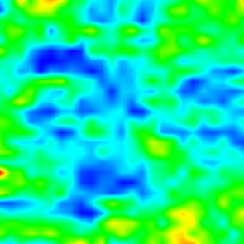
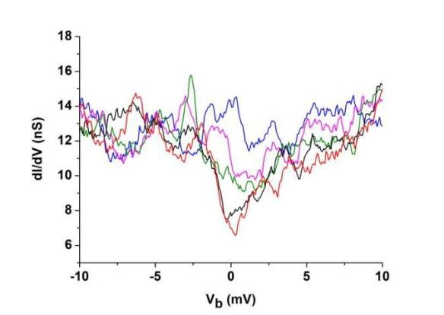
STM/STS at the scale of an extrinsic ripple
0.5
nm
Topography
(32x32 nm²)
-0.4
13.6
dI/dV maps at V_{b} = 0 mV
(T = 1.6 K)
nS
6.8
1 (two hours)
2 (two hours)
3 (two hours)
© Copyright 2013. All requests should be sent to: osvath.zoltan@ttk.mta.hu.

Slide 11
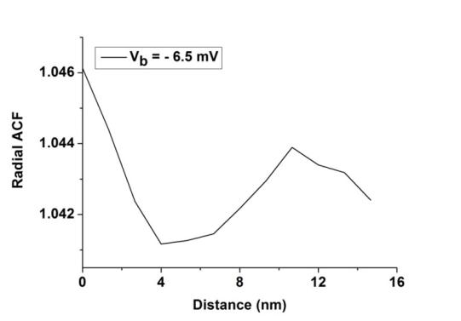
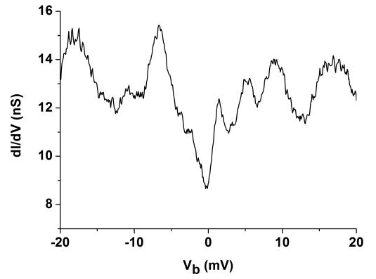


Two-dimensional Coulomb glass:
D. Menashe, O. Biham, B.D. Laikhtman, A.L. Efros, Phys. Rev. B 64 (2001) 115209
- a disordered 2D system of localized, interacting electrons in thermal equilibrium
there is a continuous rearrangement of the electronic configurations
several pseudo ground states (low energy states)
- the system drifts from one pseudo ground state to another, giving rise to the large fluctuations.
© Copyright 2013. All requests should be sent to: osvath.zoltan@ttk.mta.hu.
32x32 nm²
$$ξ≈11 nm$$
x
J. Moser, et al., Phys. Rev. B 81 (2010) 205445
(disordered graphene exposed to ozone)

Slide 12
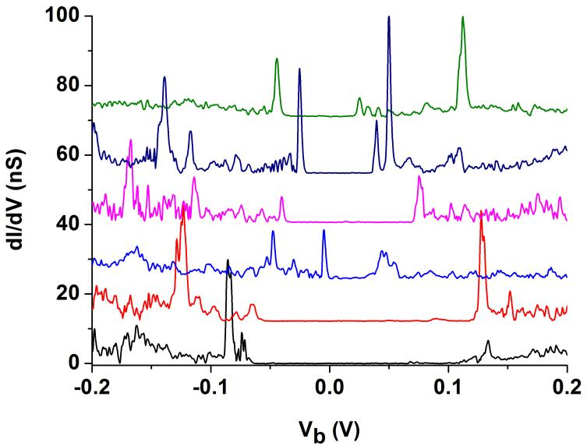
STS at high energy:
350×210 nm²
dI/dV(V) spectra:
V_{b} = − 0.2 V, I = 2 nA, V_{G} = - 25 V
© Copyright 2013. All requests should be sent to: osvath.zoltan@ttk.mta.hu.

Slide 13
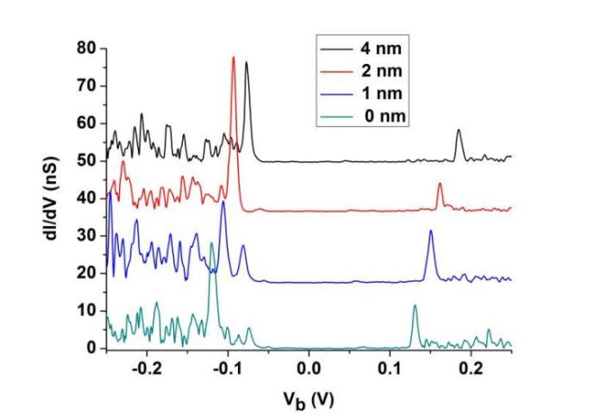
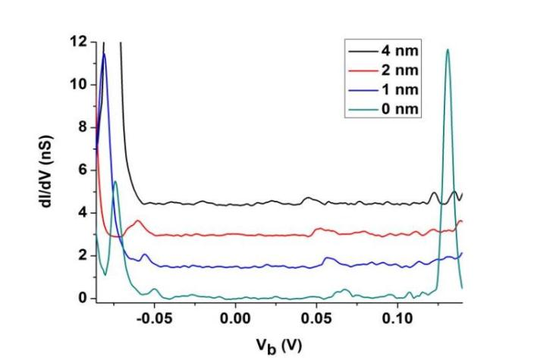
STS at high energy on an intrinsic ripple:
4
2
1
0
6.5×6.5 nm²
*
*
*
*
*
*
*
*
*
© Copyright 2013. All requests should be sent to: osvath.zoltan@ttk.mta.hu.

Slide 14
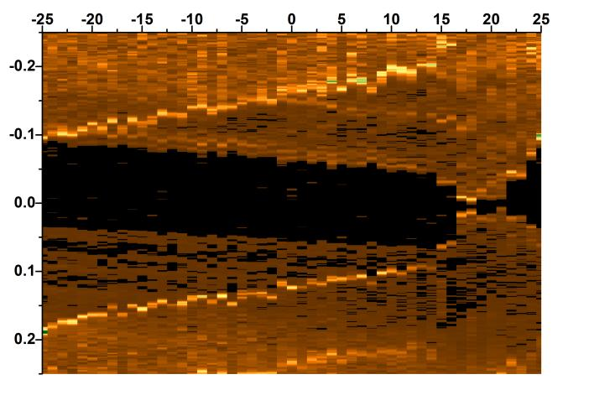
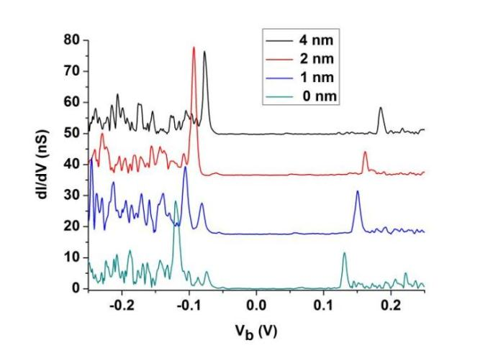
STS at high energy on an intrinsic ripple:
V_{g} (V)
4
2
1
V_{bias} (V)
0
6.5×6.5 nm²
Spectra in a fixed position
© Copyright 2013. All requests should be sent to: osvath.zoltan@ttk.mta.hu.

Slide 15
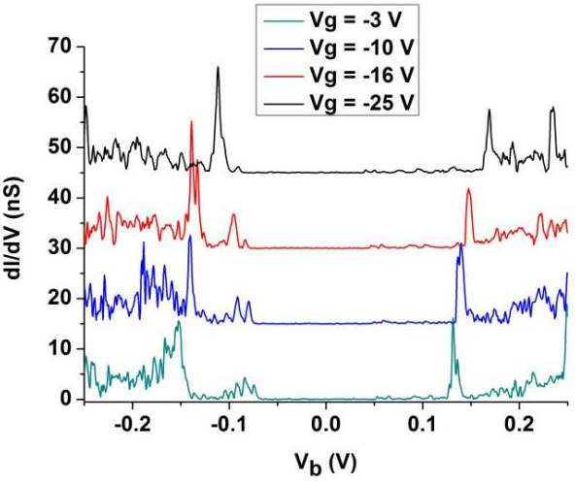
STS at high energy on an intrinsic ripple
V_{g} (V)
4
2
1
V_{bias} (V)
0
6.5×6.5 nm²
Spectra in a fixed position
© Copyright 2013. All requests should be sent to: osvath.zoltan@ttk.mta.hu.

Slide 16
STS at high energy on an intrinsic ripple:
4
2
1
0
6.5×6.5 nm²
Variation of C₁ :
STM tip
© Copyright 2013. All requests should be sent to: osvath.zoltan@ttk.mta.hu.

Slide 17
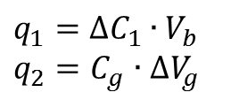
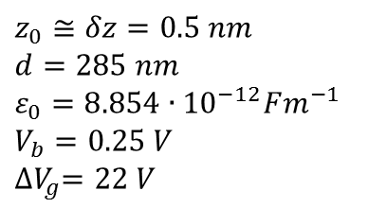
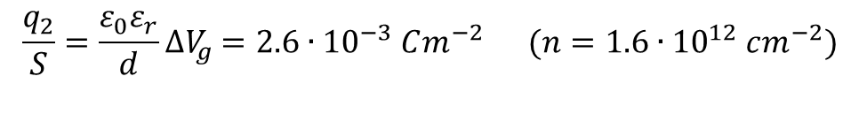
V_{b}
STM tip
C₁
C_{g}
SiO₂
V_{g}
Si⁺⁺
$$q_{1}={∆C}_{1}∙V_{b}$$
$q_{2}=C_{g}$ $∙{∆V}_{g}$
$\frac{q_{1}}{S}=\left(\frac{ε_{0}}{z_{0}}−\frac{ε_{0}}{z_{0}+δz}\right)$ $V_{b}≅\frac{ε_{0}}{2δz}V_{b}=2.2∙{10}^{−3} Cm^{−2} (n=1.3∙{10}^{12} cm^{−2})$
$$\frac{q_{2}}{S}=\frac{ε_{0}ε_{r}}{d}{∆V}_{g} =2.6∙{10}^{−3} Cm^{−2} (n=1.6∙{10}^{12} cm^{−2})$$
$$z_{0}≅δz=0.5 nm$$
$$d=285 nm$$
$$ε_{0}=8.854∙{10}^{−12}Fm^{−1}$$
$$V_{b}=0.25 V$$
$${∆V}_{g}=22 V$$
© Copyright 2013. All requests should be sent to: osvath.zoltan@ttk.mta.hu.

Slide 18
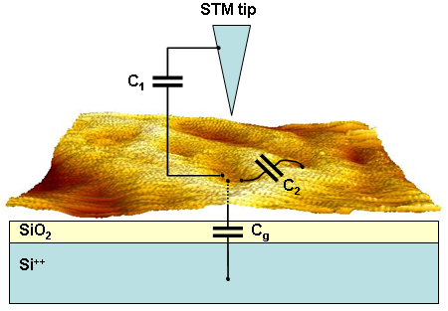
STS at high energy on an intrinsic ripple:
V_{g} (V)
V_{bias} (V)
Spectra in a fixed position
Variation of V_{g} :
E_{C} = 91 meV,
C₁ : C₂ : C_{g} = 1045 : 421: 1
→ D_{QD} = 3.6 nm
© Copyright 2013. All requests should be sent to: osvath.zoltan@ttk.mta.hu.

Slide 19
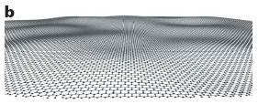
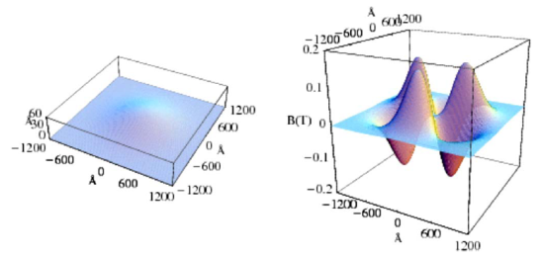
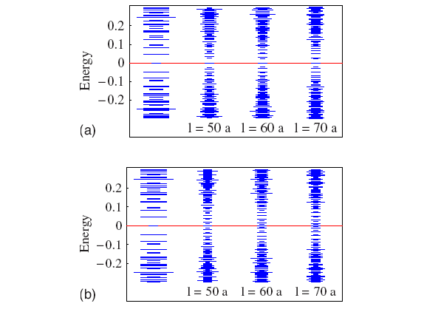
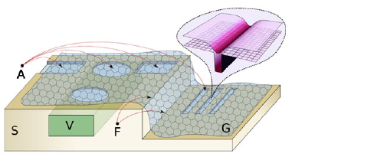
- strain induced pseudo-magnetic fields
and energy gaps:
- intrinsic rippling:
J. C. Meyer, et al., Nature 446, 60 (2007)
- local strain induced confinement:
V. M. Pereira and A. H. Castro Neto,
Phys. Rev. Lett. 103, 046801 (2009)
F. Guinea, et al.,
Phys. Rev. B 77, 075422 (2008)

Slide 20
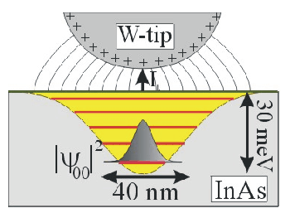
R. Dombrowski, Chr. Steinebach, Chr. Wittneven, M. Morgenstern, and R. Wiesendanger,
Tip-induced band bending by scanning tunneling spectroscopy of the states of the tip-induced quantum dot on InAs(110)
PHYSICAL REVIEW B 59 (1999) 8043

Slide 21
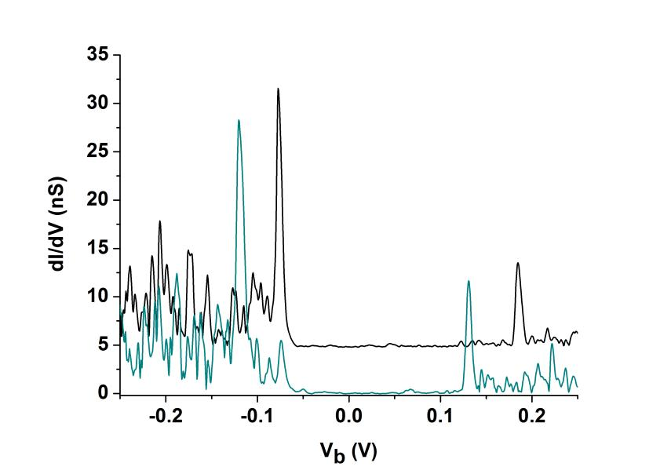
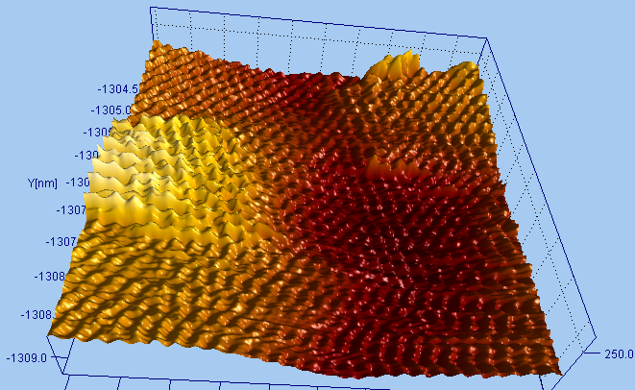
STS at high energy on an intrinsic ripple:
© Copyright 2013. All requests should be sent to: osvath.zoltan@ttk.mta.hu.

Slide 22
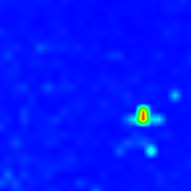
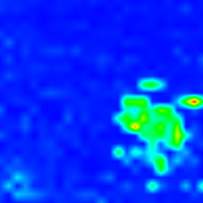
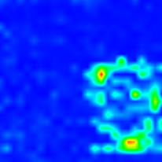
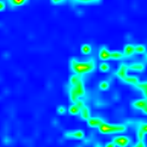
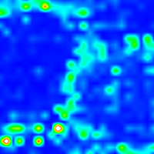
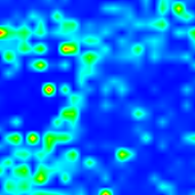

125 mV
132 mV
139 mV
146 mV
155 mV
165 mV
182 mV
The peak is measured at the same bias voltage
along constant charge density contours.
© Copyright 2013. All requests should be sent to: osvath.zoltan@ttk.mta.hu.

Slide 23





Summary:
- intrinsic rippling of graphene superimposed on the extrinsic rippling induced by the metallic contact.
Low energy spectroscopy on an extrinsic ripple:
observation of a Coulomb gap (suppression of the local DOS at the Fermi level) and slow charge fluctuations → disordered 2D system of localized ($ξ≈11 nm$), interacting electrons - glass state (T = 1.5 K).
High energy spectroscopy on an intrinsic ripple:
- appearance of a spatially dependent electronic gap and pronounced DOS peaks → formation of graphene quantum dots induced by rippling (T = 1.5 K).
shift of DOS peaks due to the change in the tip-sample capacitance along a ripple.
© Copyright 2013. All requests should be sent to: osvath.zoltan@ttk.mta.hu.

Slide 24

2. Electric transport measurements on superconductor-graphene-superconductor (SGS) junctions
Zoltán Osváth, Adrien Allain, Zheng Han, and Vincent Bouchiat
CNRS / NÉEL Institute, Grenoble
Graphene constrictions prepared by O₂ plasma etching:
Ti/Pt (10/40 nm)
© Copyright 2013. All requests should be sent to: osvath.zoltan@ttk.mta.hu.

Slide 25



Constrictions spontaneously formed during exfoliation:
AFM
- exfoliated graphene on SiO₂
- sharp (crystallografic) edges
© Copyright 2013. All requests should be sent to: osvath.zoltan@ttk.mta.hu.

Slide 26

exfoliated graphene ribbon (not etched) of ~100 nm in width
contacts: Cr/Pt (5/40 nm)
contacts are larger than designed => incomplete lift-off
© Copyright 2013. All requests should be sent to: osvath.zoltan@ttk.mta.hu.

Slide 27

deposition of Pd/Al (5/85 nm),
good resistance (quite transparent contacts): 1.5 kΩ at 50 mK.
Sn
Al
graphene
© Copyright 2013. All requests should be sent to: osvath.zoltan@ttk.mta.hu.

Slide 28


T = 50 mK
© Copyright 2013. All requests should be sent to: osvath.zoltan@ttk.mta.hu.

Slide 29

Fabry-Pérot relation:
$$E=\frac{hv_{F}}{2L}$$
E ≈ 0.18 meV
estimation for the phase coherence length:
L_{ϕ} ≈ 11.5 µm at 50 mK
© Copyright 2013. All requests should be sent to: osvath.zoltan@ttk.mta.hu.

Slide 30






$$E=\frac{hv_{F}}{2L}$$
Nature 411 (2001) 665
estimation for the
phase coherence length:

Slide 31


-deposition of Pd/Al/Pd (5/48/7 nm), then Sn (10 nm)
© Copyright 2013. All requests should be sent to: osvath.zoltan@ttk.mta.hu.

Slide 32



T=50 mK
© Copyright 2013. All requests should be sent to: osvath.zoltan@ttk.mta.hu.

Slide 33




Fabry-Pérot interference:
- fit with:
Distance between interference positions:
ΔVg = 2-5 V, which corresponds to
10-15 mV in V_{bias} .
© Copyright 2013. All requests should be sent to: osvath.zoltan@ttk.mta.hu.

Slide 34

2
3
1
V bias (mV)
© Copyright 2013. All requests should be sent to: osvath.zoltan@ttk.mta.hu.

Slide 35


Multiple Andreev reflections:
(highly transparent junction)
V_{g} = 30V
1 0.093 mV
2 0.045 mV
3 0.031 mV
4 0.023 mV
5 0.018 mV
6 0.0155 mV
Corrected bias voltages
© Copyright 2013. All requests should be sent to: osvath.zoltan@ttk.mta.hu.

Slide 36



Temperature dependence (Vg = 30V):
© Copyright 2013. All requests should be sent to: osvath.zoltan@ttk.mta.hu.

Slide 37


Corrected
gate map,
showing the
gate dependence
of the dip
© Copyright 2013. All requests should be sent to: osvath.zoltan@ttk.mta.hu.

Slide 38


© Copyright 2013. All requests should be sent to: osvath.zoltan@ttk.mta.hu.

Slide 39




B = 0 mT
B = 20 mT
© Copyright 2013. All requests should be sent to: osvath.zoltan@ttk.mta.hu.

Slide 40




Magnetic field dependence close (Vg = -20V) and far from the Dirac point (Vg = 30V):
V_{g} = 30 V
V_{g} = -20 V
© Copyright 2013. All requests should be sent to: osvath.zoltan@ttk.mta.hu.

Slide 41



Summary:
fabrication of highly transparent S-G-S junctions using tapered graphene nanostructures (sharp edges).
observation of a Josephson current and multiple Andreev reflections in S-G-S junctions (Andreev billiard).
modulation of both the switching current and normal state resistance by Fabry-Pérot interference → indicates quasi-ballistic transport (T = 50 mK).
estimation for the phase coherence length: L_{ϕ} ≈ 11.5 µm at T = 50 mK.
”ON” and ”OFF” states in the Josephson current: modulated by a gate voltage.
© Copyright 2013. All requests should be sent to: osvath.zoltan@ttk.mta.hu.

Slide 42
Acknowledgements:
CEA-Grenoble, INAC
Dr. Marc Sanquer
Dr. Claude Chapelier
Dr. François Lefloch
Dr. Thomas Dubouchet
Dr. Guillaume Albert
Dr. Giorgos Katsaros
CNRS, Institut Néel
Dr. Vincent Bouchiat
Dr. Adrien Allain
Dr. Nedjma Bendiab
Dr. Laetitia Marty
Dr. Valerie Reita
Zheng Han (Vitto)
Thank you for your attention.
Projects: FP7-NMP-2009-SMALL-3 Grenada, the grant Supergraph from the “Agence Nationale de la Recherche”, the French-Hungarian bilateral programme PHC-Balaton/TÉT_10-1-2011-0752, the micro-nano grant Contact metal-graphene from the Rhône-Alpes region, the “Plateforme Technologique Amont de Grenoble”, the project Dispograph financially supported by the “Nanosciences aux limites de la Nanoélectronique” Foundation and the CNRS technology network ReNaTech.

Slide 46

V_{g} (V)
V_{bias} (V)
V_{G}
V_{b}
© Copyright 2013. All requests should be sent to: osvath.zoltan@ttk.mta.hu.

Slide 47


6.5×6.5 nm²
© Copyright 2013. All requests should be sent to: osvath.zoltan@ttk.mta.hu.

Slide 48




Slide 49

© Copyright 2013. All requests should be sent to: osvath.zoltan@ttk.mta.hu.

Slide 50


AFM Height
AFM Amplitude error
© Copyright 2013. All requests should be sent to: osvath.zoltan@ttk.mta.hu.

Slide 51

We can define 3 regions:
© Copyright 2013. All requests should be sent to: osvath.zoltan@ttk.mta.hu.

Slide 52
R_{wires} = 450 Ω
Vg = 30 V
Dip 1: V1 = 0.58 mV; I1 = 0.73 μA; V1’ = V1 – I1×R_{wires} = 0.25 mV; P1 = I1xV1’ = 0.18 nW
Dip 2: V1 = 1.05 mV; I2 = 1.25 μA; V2’ = 0.49 mV; P2 = I2xV2’ = 0.61 nW
Dip 3: V1 = 1.41 mV; I3 = 1.66 μA; V3’ = 0.66 mV; P3 = I3xV3’ = 1.1 nW
Vg = - 20 V
Dip 1: V1 = 0.58 mV; I1 = 0.52 μA; V1’ = 0.34 mV; P1 = I1xV1’ = 0.18 nW
Dip 2: V1 = 1.1 mV; I2 = 0.96 μA; V2’ = 0.67 mV; P2 = I2xV2’ = 0.64 nW
Dip 3: V1 = 1.4 mV; I3 = 1.21 μA; V3’ = 0.85 mV; P3 = I3xV3’ = 1.03 nW
© Copyright 2013. All requests should be sent to: osvath.zoltan@ttk.mta.hu.

Slide 53





Slide 54


Problem of PVD:
STM image (RT)
~ 170 nm high edges, i.e. 3 times higher than the deposited metal (55 nm)
→ very difficult to perform low-temperature STM at the metal-graphene interface
PMMA 4%
lift-off : →
© Copyright 2013. All requests should be sent to: osvath.zoltan@ttk.mta.hu.

Slide 55



32x32 nm²
13.6
nS
6.8
1
© Copyright 2013. All requests should be sent to: osvath.zoltan@ttk.mta.hu.

Slide 56

14.8
nS
8.8
32x26 nm²
0.5
nm
-0.4
V_{b} = -7mV, I = 100 pA, V_{g} = 25V
© Copyright 2013. All requests should be sent to: osvath.zoltan@ttk.mta.hu.

Slide 57



32x32 nm²
dI/dV maps at E_{F}
(T = 1.6 K)
13.6
nS
6.8
1
2
3
© Copyright 2013. All requests should be sent to: osvath.zoltan@ttk.mta.hu.

Slide 58





