Slide 1
Andreev Bound States
Seminar BME, 26.04.2013
Samuel d‘Hollosy

Slide 2
Outline
S
S
B
Bogoliubov-de Gennes
Andreev Reflection
Ballisitc Junction
S
S
N
S
S
N
S
S
S
S
N
B
Spin Resolved Andreev Levels
Yu-Shiba-Rusinov Bound States
Andreev Bound States

Slide 3
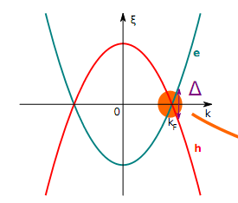
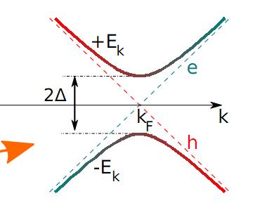
Bogoliubov – de Gennes
S
P. Joyez, Lecture 1, Capri Spring School 2012

Slide 4
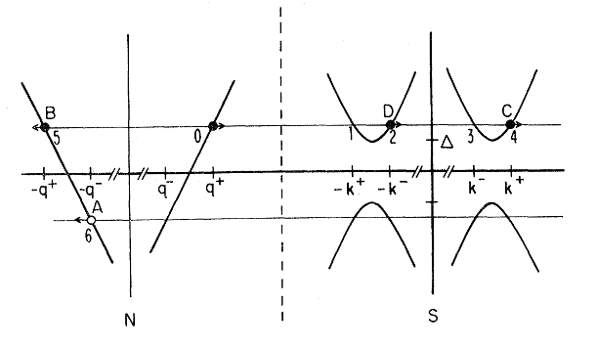
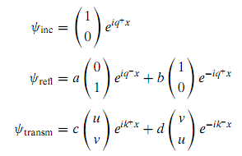
Andreev Reflection
S
N
BTK
H. Lüth, Solid Surfaces, Interfaces & Thin Films, Springer, 2010

Slide 5
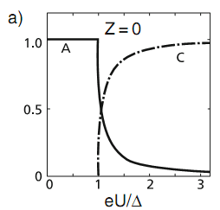
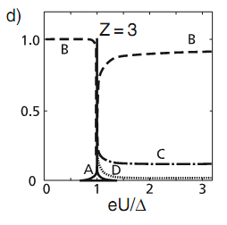
BTK Results
S
N
A: Probability of Andreev Reflected hole
B: Probability of specular reflected electron
C,D: Probability of Quasiparticle Injection
Z: Dimension less parameter for the barrier strength
S
N
Transport through a tunnel probe (Z »1 ) is only above the gap, through excited states
S
N
H. Lüth, Solid Surfaces, Interfaces & Thin Films, Springer, 2010

Slide 6
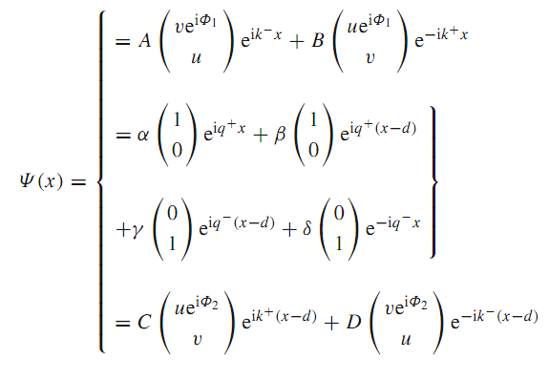
Ballistic Junction
S
S
N
BTK for two interfaces Matching Wavefunctions
H. Lüth, Solid Surfaces, Interfaces & Thin Films, Springer (2010)

Slide 7
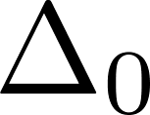
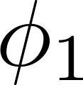
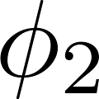
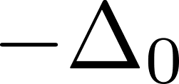
Andreev Bound State
S
S
N
Ballistic short channel with ballisitc interface

Slide 8
Andreev Bound State
S
S
N
Ballistic short channel with ballisitc interface

Slide 9
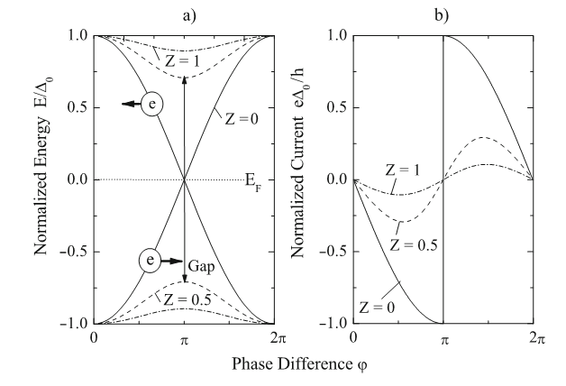
Andreev Bound State
S
S
N
H. Lüth, Solid Surfaces, Interfaces & Thin Films, Springer, 2010

Slide 10
Problems
S
S
Scattering
Spin flip processes
Interactions U
S
S
B
B
S
S
B
B
S
S

Slide 11
Scattering Matrix Approach
S
S
B
B
P. Joyez, Lecture 1, Capri Spring School 2012

Slide 12
Mesoscopic Josephons Junction
S
S
B
B
Ballisitic interface, reflectice short channel compared to L_{φ} , ξ_{S}
Supercurrent reversal only when branch crosses 0
P. Joyez, Lecture 1, Capri Spring School 2012

Slide 13
Problems
S
S
Scattering
Single SC / Spin flip
Interactions U
S
S
B
B
S
S
B
B
S
S

Slide 14
Yu-Shiba-Rusinov
S
B

Slide 15
Anderson Impurity Model
S
S
T. Meng et al. , Self consistent description of Andreev Bound States ... , Phys. Rev. B 79, 224521, (2009)

Slide 16
Results from theory
S
S
Effective Hamiltonian:
Local pairing amplitude:
Add the interaction energy
T. Meng et al. , Self consistent description of Andreev Bound States ... , Phys. Rev. B 79, 224521, (2009)

Slide 17
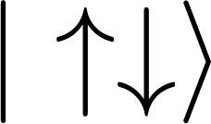
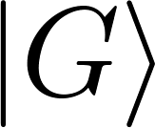
Sequential Transport
N
N
N
N

Slide 18
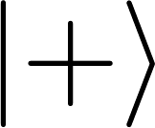
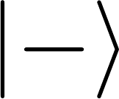
Local pairing
S
S
Andreev Reflection
∆, Γ

Slide 19
Exchange Interaction
S
S
Spin Flip Scattering
U, Γ
Notes:
Or Quantum mechanical exchange interaction or Kondo effect

Slide 20
Large Interaction
S
S
P. Joyez, Lecture 2, Capri Spring School 2012

Slide 21
Medium Interaction
S
S
P. Joyez, Lecture 2, Capri Spring School 2012

Slide 22
Weak Interaction
S
S
P. Joyez, Lecture 2, Capri Spring School 2012

Slide 23
Quantum Phase Diagram
S
S

Slide 24
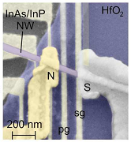
Apply Magnetic Field
S
N
B
E. Lee et al. Spin-resolved Andreev Levels ... , arXiv:1302.2611v1 (2013)

Slide 25
S
N
B
E. Lee et al. Spin-resolved Andreev Levels ... , arXiv:1302.2611v1 (2013)

Slide 26
Summary
S
S
S
B
B
S
S
N

Slide 27
Awaiting questions?
Thank you for your attention

