Slide 1
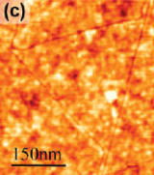
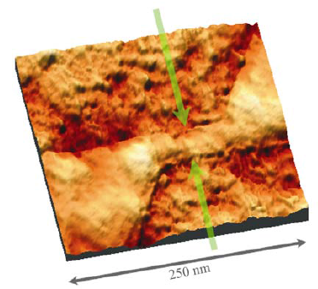
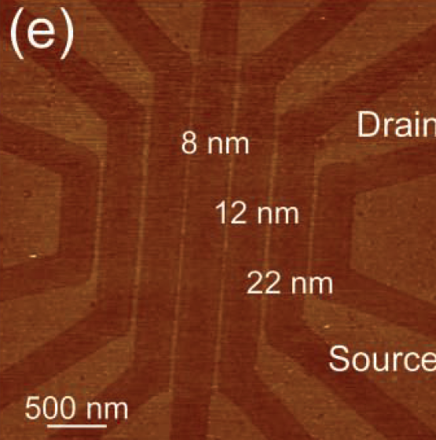
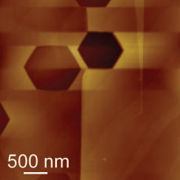
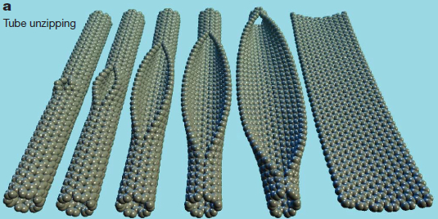
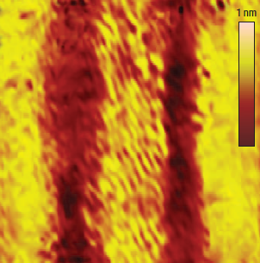
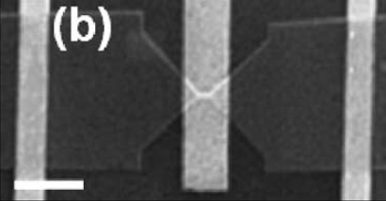
A few things you’ve (n)ever wanted to know about Graphene Nanoribbons (GNRs)
Tóvári Endre, nanoszeminárium ea., 2013. máj.31.

Slide 2
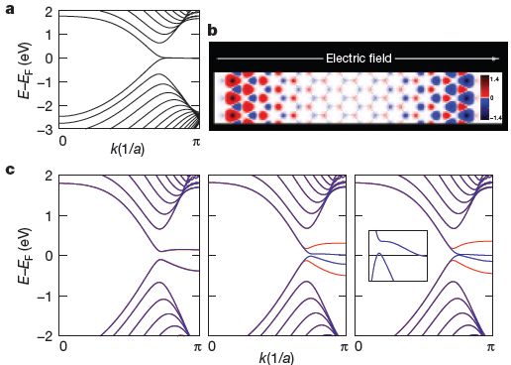
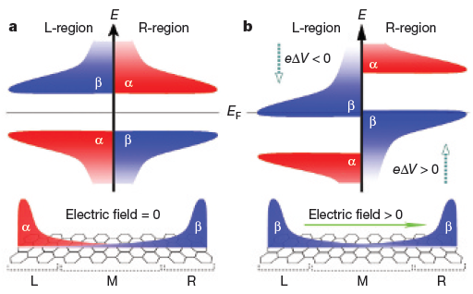
Motivation: graphene nanoribbons
A lot of methods, with different degrees of details
Overview of basic transport properties
Y.-W. Son, M. L. Cohen, S. G. Louie, Nature Letters, Vol. 444, 16 November 2006

Slide 3
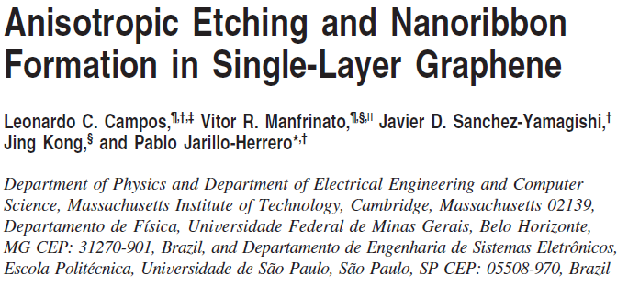
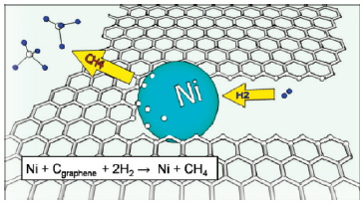
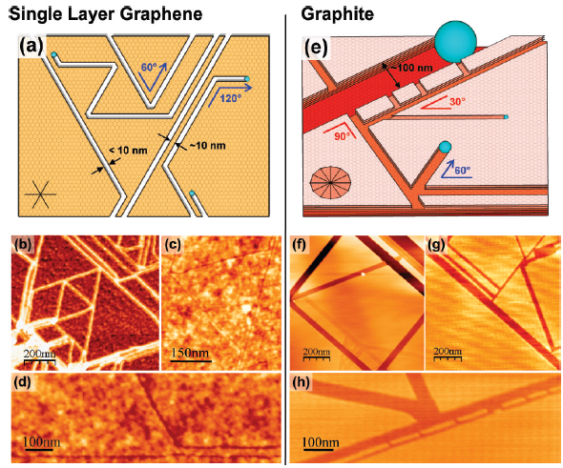
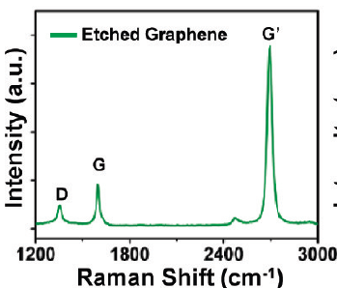
NANO LETTERS, 2009, Vol. 9, No. 7, 2600-2604

Slide 4
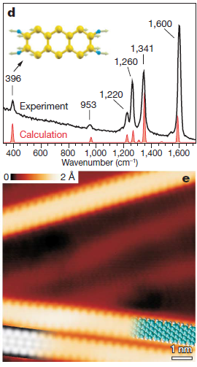
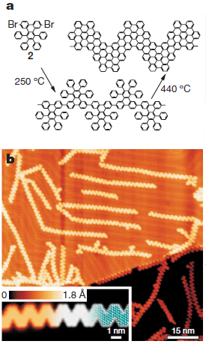
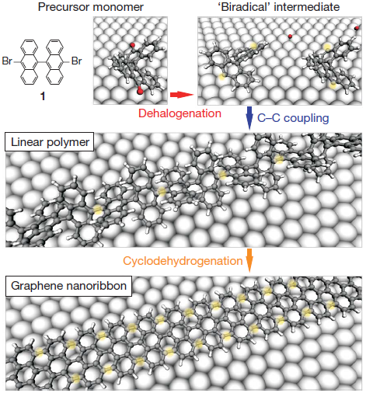
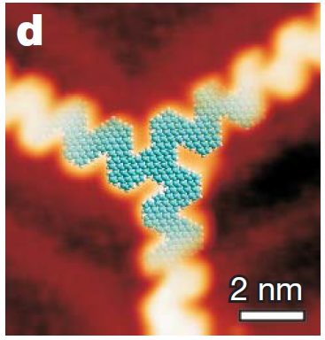
on Au(111) single crystal
STM
Molecular model
DFT-sim.
Nature 466, 470–473 (22 July 2010)

Slide 5
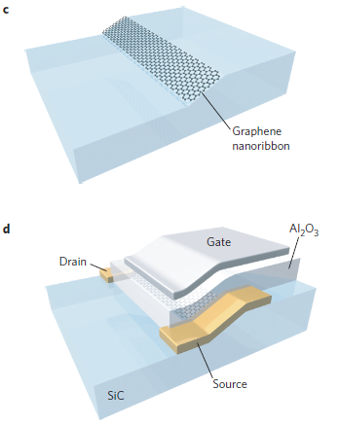
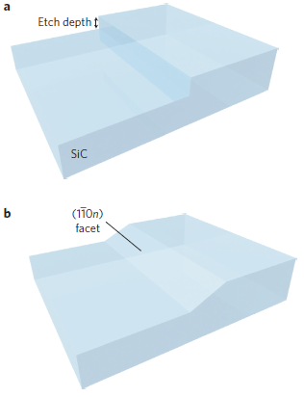
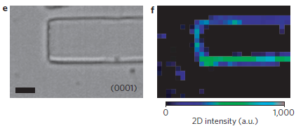
Fluorine-assisted Reactive Ion Etching of SiC
Self-organized GNR formation
2 µm
Step flow and relaxation at 1300°C
Gate dielectric (39nm thick) and top gate fabrication
Nature Nanotechnology 5, 727–731 (2010)

Slide 6
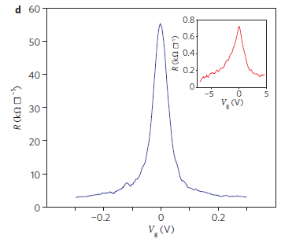
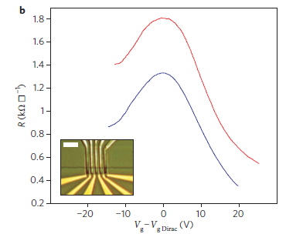
GNRs on SiC
V_{D}=-4V
2-terminal, top gated
2-terminal, top gate length 450 nm
Room temp.
Probably a few layers
RT
„representative ribbons”
4K
40 nm
Mobility 900-2700 cm²/Vs
Nature Nanotechnology 5, 727–731 (2010)
Notes:
SiO₂: dn/dV_{g}≈0,07*10¹² cm⁻²/V

Slide 7
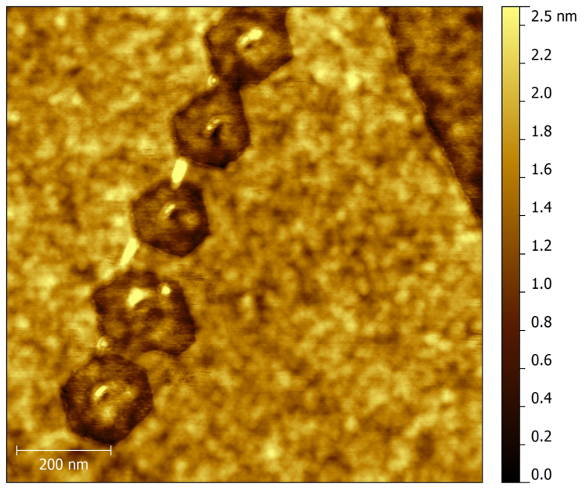
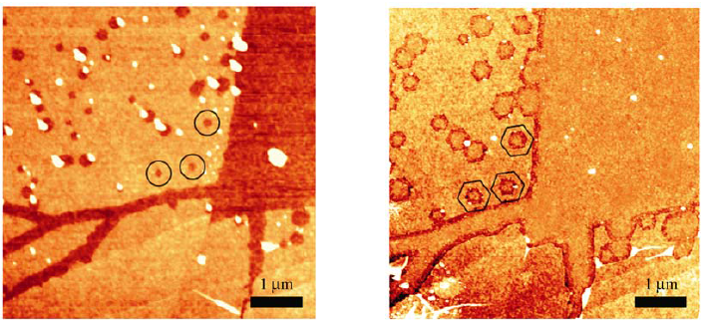
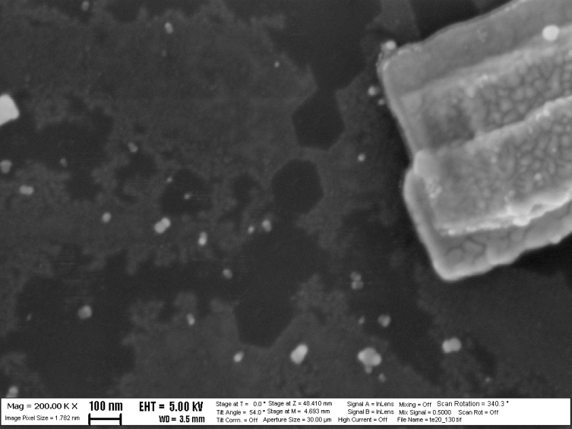
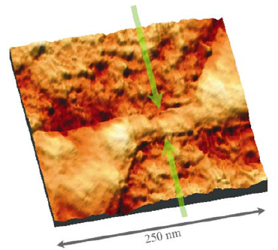
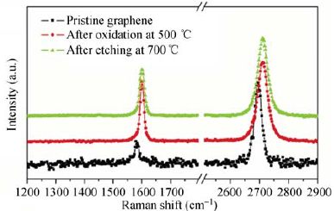
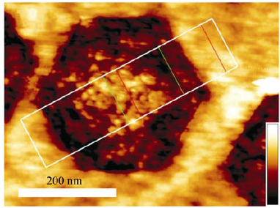
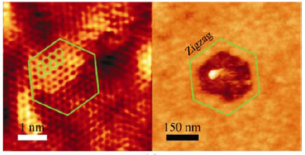
Carbothermal etching
SiO₂+C
700°C in Ar
35 nm
Nano Res (2010) 3: 110–116

Slide 8
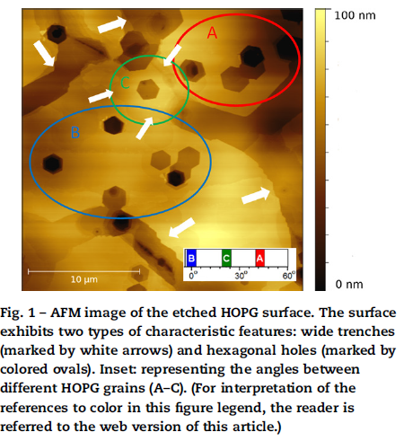
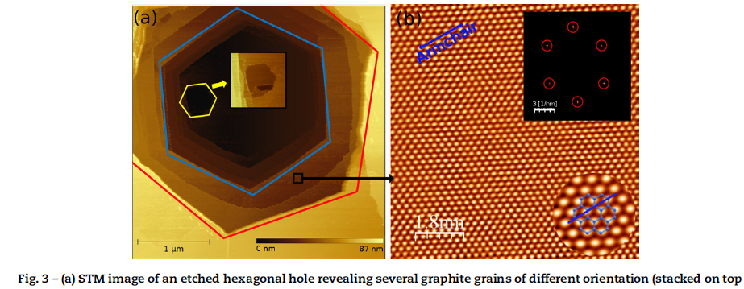
Selective etching of armchair edges in graphite
annealing HOPG in an oxygen containing (<45%) atmosphere: 600°C, 5-20 min
C A R B ON 5 6 ( 2 0 1 3 ) 3 3 2 –3 3 8
G. Dobrik *, L. Tapaszto´ , L.P. Biro

Slide 9
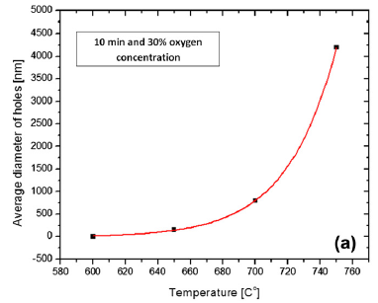
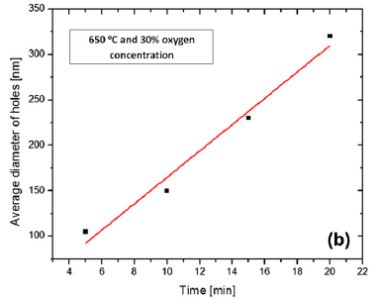
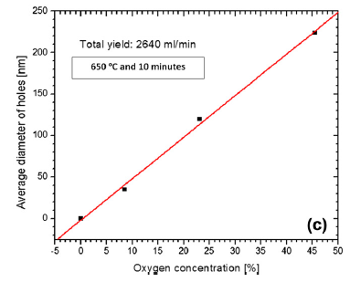
Selective etching of armchair edges in graphite
C A R B ON 5 6 ( 2 0 1 3 ) 3 3 2 –3 3 8

Slide 10
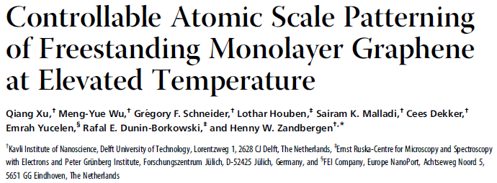
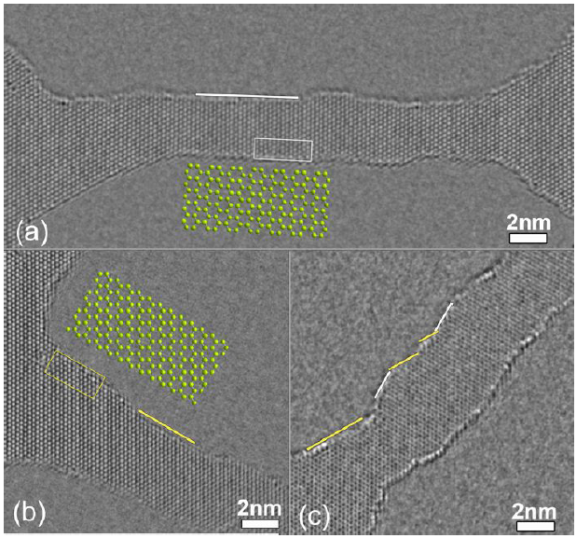
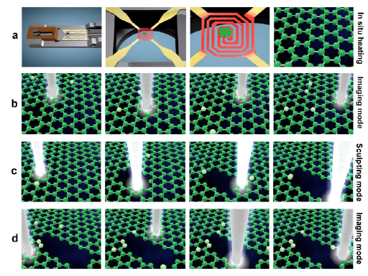
MEMS heater used for ultrastable in situ heating of graphene inside the TEM, used for self-repair of graphene defects
STEM imaging of graphene is achieved by fast scanning
is achieved by scanning 1000 times slower by using a longer dwell time
Orientation selective

Slide 11
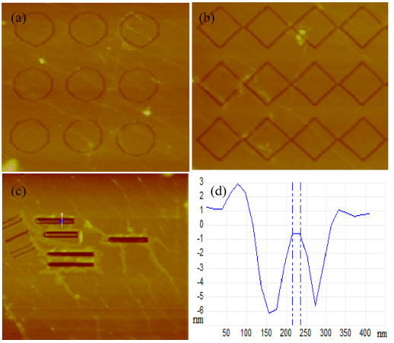
AFM-cutting
Appl. Phys. Lett. 101, 213101 (2012)

Slide 12
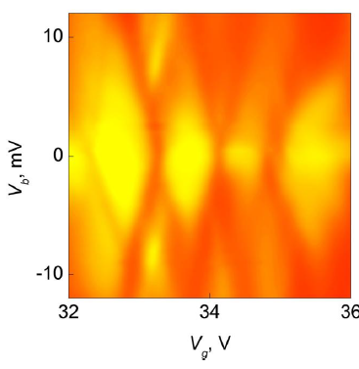
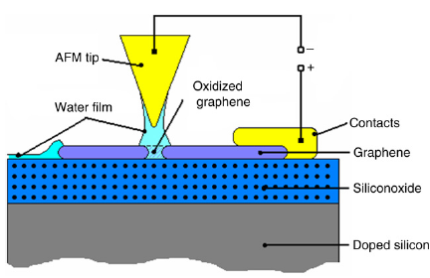
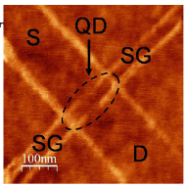
AFM-tip assisted electrochemical etching
2,5K
0,002-0,2 e²/h
Small. 2010 Jul 19;6(14):1469
Solid State Communications 147 (2008) 366

Slide 13
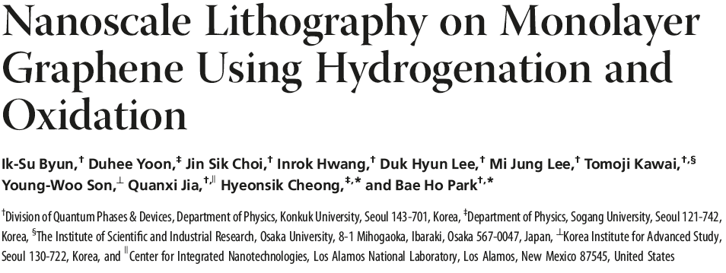
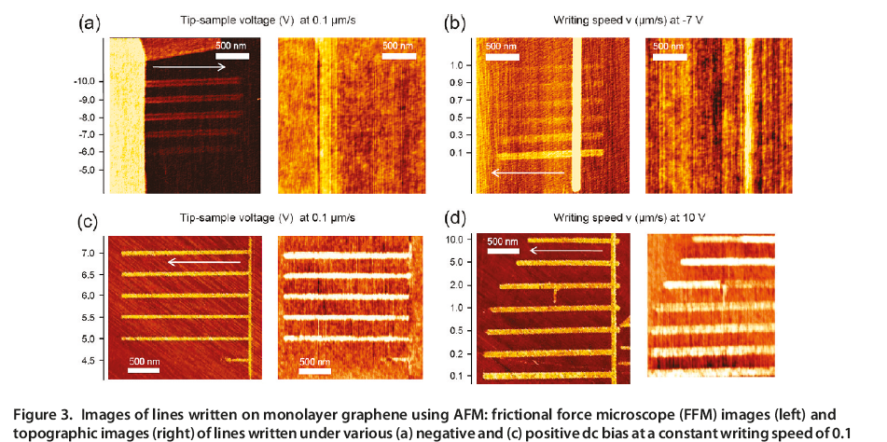
Water dissociation due to DC voltage, polarity-dependent reaction to graphene (H or O)

Slide 14
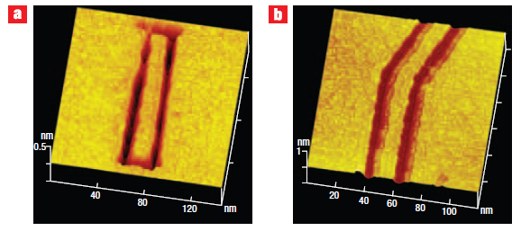
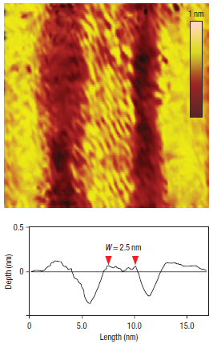
Nature Nanotechn. 3, 397 (2008)

Slide 15
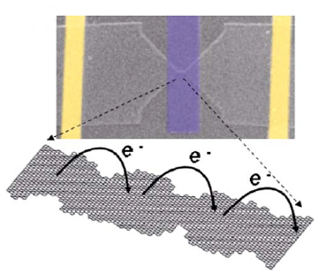
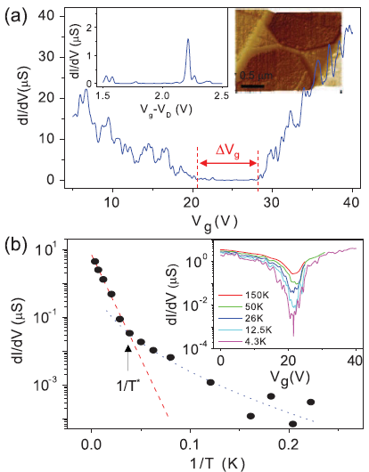
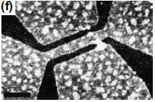
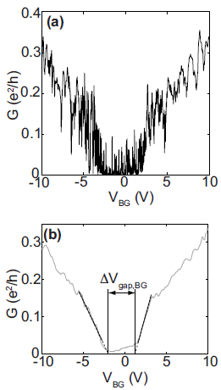
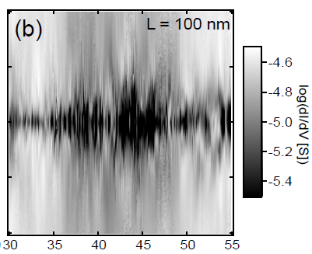
PRL 98, 206805 (Han):log scales, 1,7K
24 nm x 2 um: hole mob.110,
49 nm x 2 um: 215
71 nm: 875 cm2/Vs
Electron-beam lithography and plasma etching
Mobilities estimated by me based on PRB 78, 161409
Appl. Phys. Lett. 91, 192107 2007
PRL 104, 056801 (2010)
85 nm x 500 nm
Han: µh~160, µe~570
Enslin: side gated! No corr., µh~1490
Reproducible cond.peaks in the gap region
Avouris PRB 78, 161409
30 nm x 850 nm: 200 mob. (80K)
30x900 nm: 165 (90K)
30x1700 nm: 130 (33K)
protective mask
Molitor, …, Enslin, PRB 79, 075426, 2009
Adv. Mater. 2011, 23, 3061–3065:
L=500 nm, RT
Estimated mobilities (log scale!)
W= 6 nm: µh~18 cm^2/Vs
W=10 nm: µh~41
22 nm: 51
45 nm: 300
80 nm: 640
1000 nm: 3290
Graphene edge lithography:
RT, 10 nm x 700 nm: mob.26 (VSD=1V)
RT, 20 nm, 700 nm(?): 9 (maybe already top-gated, ireelevant model
Han: µh~160, µe~570
Enslin: side gated! No corr., µh~1490
Avouris Physica E 40 (2007) 228 (nem az a PRB-s cikk a kapacitásról): 200 nm oxid, 100nmx1000nm,4K, µ~530
36 nm wide, 500 nm long
10 µS≈0,129 e²/h
Arxiv 0909.3886v2:
300 nm oxid, 30x200nm, µh~42
arXiv:0909.3886v2

Slide 16
Electron-beam lithography and plasma etching
arXiv:0909.3886v2
Suggestion:
Confinement gap
Disorder potential: edge roughness+potential inhomogeneities (charged impurities in the substrate)→”puddles” and tunnel barriers
Multiple quantum dots in series/parallel
Why?
The transport gap is given by the confinement+disorder amplitude
QDs in series: overlapping Coulomb-diamonds in the stability diagram

Slide 17
Electron-beam lithography and plasma etching
PRL 104, 056801 (2010)
arXiv:0909.3886v2
Distance from V_{g}=0 increases with the value of the transport gap ΔV_{g}
Annealing (Ar, 300°C) shrinks the transport gap, the SD-gap changes arbitrarily (rearrangement)
No correlation between the 2 gap values
ΔV_{g} →it’s a measure of sample doping by charged impurities of the substrate; really determinded by the disorder potential
Length:
W=30 nm

Slide 18
Electron-beam lithography and plasma etching
arXiv:0909.3886v2
The transport gap has little length dependence, unlike the SD-gap:
Only qualitative trend, but supports the picture: a longer ribbon has more QDs whose energies need to be appropriately positioned

Slide 19
Electron-beam lithography and plasma etching
A few things of interest
Constant peak spacing (within the transport gap) in a 200 nm-long (!) and 30 nm wide ribbon
(in a certain region of backgate voltage):
Single QD-like behaviour
Short ribbons: might be smaller then the average puddle of localized carriers (~20nm), no transport and SD-gap,
Fabry-Pérot-like oscillations (like CNTs)
µ_{h}~42 cm²/Vs
arXiv:0909.3886v2

Slide 20
Electron-beam lithography and plasma etching
A few things of interest
From peak spacing (0,05V) and ribbon geometries→ 100 nm long QD in the 200 nm x 30 nm ribbon
arXiv:0909.3886v2

Slide 21
Electron-beam lithography and plasma etching
Fabrication method with e-beam lithography and plasma etching:
Usual resist etch mask + Ti etch mask (30 nm wide line), later removed by HCl
900 nm x 30 nm
Additional lithography step:
Bulk mobility 6000 cm²/Vs →800 cm²/Vs
500 nm
arXiv:0909.3886v2

Slide 22
Electron-beam lithography and plasma etching
About width dependence
arXiv:0909.3886v2
(?)
PRL 104, 056801 (2010)

Slide 23
Electron-beam lithography and plasma etching
PRL 104, 056801 (2010)
T>T*:
thermally activated transport
E_{a}=285K
T<T*: variable range hopping, γ=1/2

Slide 24
Electron-beam lithography and plasma etching
PRL 104, 056801 (2010)

Slide 25
Molitor, …, Enslin, PRB 79, 075426, 2009
65 nm x 100 nm
See also: PRL 108, 266601 (2012)

Slide 26
H-plasma etching
etching at ~500°C
edges parallel with the zigzag direction
TEM:
edge roughness<1nm
Adv. Mater. 2010, 22, 4014–4019
Adv. Mater. 2011, 23, 3061–3065

Slide 27
H-plasma etching
dashed: bulk graphene
L=500 nm, room temp., vacuum
10 mV
Capac.?
500 kΩ
Max.
Adv. Mater. 2011, 23, 3061–3065

Slide 28
Edge lithography
Atomic Layer Deposition: selective, prefers edges (dangling bonds, passivated chemical groups)
monolayer GNR
Nano Lett. 2012, 12, 4642−4646

Slide 29
Edge lithography
top-gated devices:
S, D electrodes defined before ALD (4 nm Al₂O₃)
original graphene edge: mechanically cleaved
10 nm x 700 nm
vacuum, room temp.
Mobility estimated by them: ~400 cm²/Vs
Mob. estimated by me, supposing a simple model: 840
Mob. est. by me, capac. model of Avouris: 26 cm²/Vs
V_{DS}=1V
Nano Lett. 2012, 12, 4642−4646

Slide 30
Few-layer ribbons
All scale bars 100 nm
Graphite: chemical intercalation of oxidizing sulfuric acid and nitric acid: oxidation of carbon atoms likely occurring at the edge, step, and defect sites
rapid heating of the expandable graphite to 1000°C caused violent formation of volatile gaseous species from the intercalant and exfoliates graphite; thermally desorbing covalently attached species and repair defects
1,2-dichloroethane (DCE) solution of poly(m-phenylenevinylene-co-2,5-dioctoxy-p-phenylenevinylene) (PmPV) by sonication for 30 min; then centrifugation to remove larger pieces: noncovalent functionalization
Deposition+400°C to remove PmPV
Science 319, 1229 (2008)

Slide 31
Chemically Derived, Ultrasmooth Graphene Nanoribbons
Room temp.
1MΩ
Bilayer, 9 nm x 130 nm
Linear charact. far from the Dirac point
Mobility<10?
Their mob. estimation:
100-200
bilayer, 5 nm x 210 nm
Science 319, 1229 (2008)

Slide 32
Chemically Derived, Ultrasmooth Graphene Nanoribbons
empirical fit: E_{g}=0,8[eV]/W[nm]
V_{DS}=0,5V
armchair GNR calc.
zigzag GNR calc.
the off current is thermally activated through a body Schottky-barrier (~E_{g}) to the cond.band (the barrier for holes is small, like SWNT FETs, because of the high work function of the Pd contacts)
Science 319, 1229 (2008)
Phys. Rev. Lett. 2008 , 100 , 206803 .

Slide 33
Unzipping carbon nanotubes
solution-based oxidative process for producing a nearly 100% yield of nanoribbon structures by lengthwise cutting and unravelling of multiwalled carbon nanotube (MWCNT) side walls.
Single layer on Si
Nature 458, 872-876 (16 April 2009)

Slide 34
Unzipping carbon nanotubes
as-prepared
N2H4-reduced: 0,03 e²/h
H2-annealed: 0,28 e²/h
300nm wide, 10nm thick (AFM) with a channel length of 500nm
Reduced and annealed bilayer: G_{min}~0,0023 e²/h
Nature 458, 872-876 (16 April 2009)

Slide 35
unzipping MWCNTs by plasma etching of nanotubes partly embedded in a polymer film. The GNRs have smooth edges and a narrow width distribution (10–20 nm)
180°
100 nm
Nature 458, 877-880 (16 April 2009)

Slide 36
Unzipping carbon nanotubes
Single-layer
G-band map
16 nm wide, ~200 nm long ribbon after current annealing; in vacuum:
7 nm wide ribbon, in air:
Mob. 20
G_{min}~0,01e²/h
G_{min}~0,17 e²/h
Nature 458, 877-880 (16 April 2009)

Slide 37
Unzipping „mildly gas-phase oxidized multiwalled carbon nanotubes” using mechanical sonication in an organic solvent; the yield of GNRs is ~2%
TEM:
Almost atomically smoooth edges
Nature Nanotechnology 5, 321 - 325 (2010)

Slide 38
Unzipping carbon nanotubes
~20 nm wide bilayer ribbon
Low ratios of disorder to graphitic Raman bands
Nature Nanotechnology 5, 321 - 325 (2010)

Slide 39
14 nm wide bilayer ribbon, V_{b}=1mV
Unzipping carbon nanotubes
Random contacts (previous lithography)
1,500 cm²/Vs mobility for 14 nm wide ribbons!
Fabry-Pérot-like interference pattern at 4,2 K
Bilayer ribbons with different methods at ROOM TEMP.
Nature Nanotechnology 5, 321 - 325 (2010)

Slide 40
Mob. 1250 @ 4K
QHE at 4K, bulk mobility 7000
APPLIED PHYSICS LETTERS 94, 082107 2009

Slide 41
method | W (nm) | L (nm) | G min (µS) | G max (µS) | T (K) | µ (cm²/Vs) | source | mob. est. by:
EBL+RIE | 24 | 2000 | <0.01 | >4 | 1.7 | 110 | PRL 98, 206805 | ET
 | 49 | 2000 | 0.01 | >20 | 1.7 | 215 |  | ET
 | 71 | 2000 | 0.5 | >40 | 1.7 | 875 |  | ET
 | 85 | 500 | <<1 | >40 | ? | 160-570 | PRL 104, 056801 (2010) | ET
 | 30 | 850 | 3 | >14 | 80 | 200 | Avouris PRB 78, 161409 | ET
 | 30 | 900 | 1 | >9 | 90 | 165 |  | ET
 | 30 | 1700 | <0.1 | >2.5 | 33 | 130 |  | ET
 | 100 | 1000 | 11 | >60 | 4 | 530 | Physica E 40 (2007) 228 | ET
 | 30 | 200 | <0.15 | >15 | 4.2 | 42 | 0909.3886v2 | ET
H-plasma | 6 | 500 | 1.8 | >4 | RT | 18 | Adv. Mater. 2011, 23, 3061 | ET | their mobility estimate >1000
 | 10 | 500 | 3.5 | >10 | RT | 41 |  | ET
 | 22 | 500 | 11 | >35 | RT | 51 |  | ET
 | 45 | 500 | 35 | >140 | RT | 300 |  | ET
 | 80 | 500 | 110 | >300 | RT | 640 |  | ET
 | 1000 | 500 | 1200 | >4000 | RT | 3290 |  | ET
edge litho | 10 | 700 | 1.5 | >7 | RT | 26 or 400 | Nano Lett. 2012, 12, 4642 | ET/them
sonochem. | 9 | 130 | <0.01 | >2 | RT | <10 or 100-200 | Science 319, 1229 (2008) | ET/them
AFM LAO | 55 | 800 | 2 | >90 | 4.2 | 1250 | APL 94, 082107 2009 | ET
CNT unzip | 14 | 200 | <4 | >116 | 20 | 271 or 1500 | Nature Nano5, 321 (2010) | ET/finite element modelling
our GNRs
EBL+plasma | 60 | 570 | <50 | >97 | RT | 17 | 120813cb | my est.based on:
 | 60 | 570 | <0.01 | >38 | 4 | 35-188 |  | Avouris PRB 78, 161409
 | 105 | 550 | 10 | >170 | 4 | 990 | 120814cb 1-11
 | 80 | 550 | 0.2 | >58 | 4 | 530-765 | 2-9
 | 80 | 550 | 2 | >58 | 4 | 660-1200 | 4-8
 | 415 | 275 | <54 | >70 | 4 | 22 | 120320ca strip
 | 110 | 400 | 0 | >15 | 4 | 25 | 121218cp2b 3-4
 | 120 | 400 | <0.04 | 4 | 4 | 28-37 | 16-17
 | 130 | 400 | 0 | 3 | 4 | 7 | 12-13
AFML
120319cd | 30 | 920 | <54 | >116 | RT | 5133
 | 30 | 920 | <0.01 | <35 | 4 | -
CTE
120320ca | 35 | 70 | ? | <2.1 | 4 | -

Slide 42
Thank you for your attention!

Slide 43
Spatially resolving edge states of
GNRs from unzipping CNTs
7K
atomic order
predicted edge state bandgaps
24 meV
Nature Physics 7, 616–620 (2011)

Slide 44
Spatially resolving edge states of
GNRs from unzipping CNTs
20 nm wide GNR on Au(111)
Nature Physics 7, 616–620 (2011)

Slide 45
Engineering the edge termination
GNRs from unzipping CNTs, then H-plasma treatment
hydrogen plasma etches away the original edge groups and develops segments with different chiralities along the edge
room temp.
calc.
ACS Nano, 2013, 7 (1), pp 198–202

