Slide 1
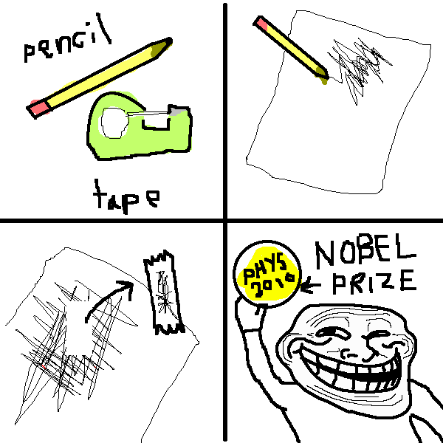
Van der Waals heterostructures
BME nanoseminar
2014.03.24.

Slide 2
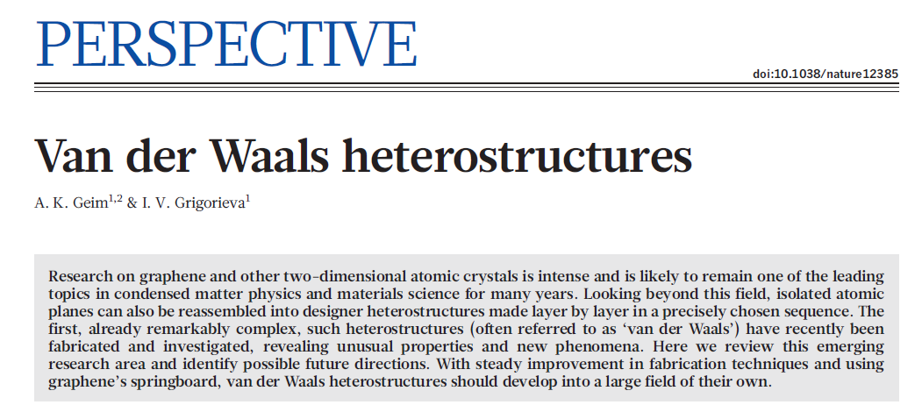
Felvezetés

Slide 3
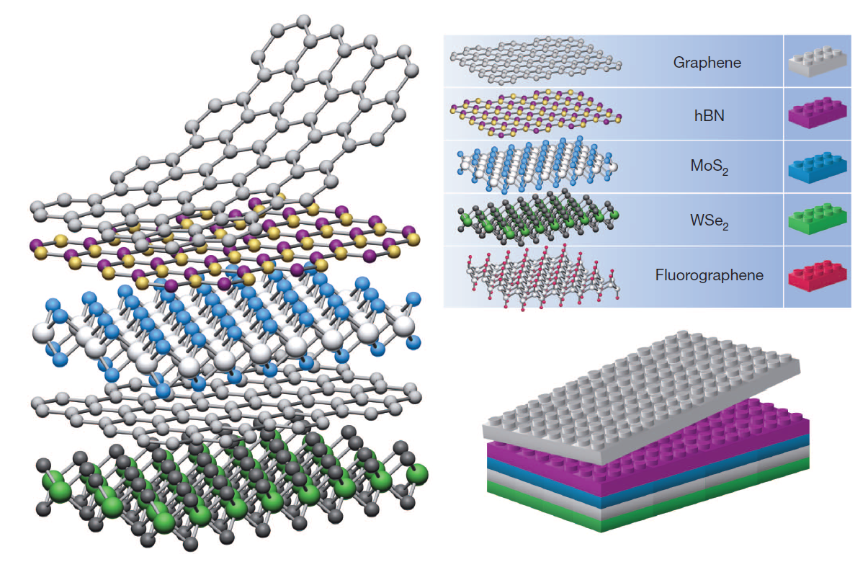
Building van der Waals heterostructures
If one considers 2D crystals to be analogous to Lego blocks (right panel), the construction of a huge variety of layered structures becomes possible. Conceptually, this atomic-scale Lego resembles molecular beam epitaxy but employs different ‘construction’ rules and a distinct set of materials.

Slide 4
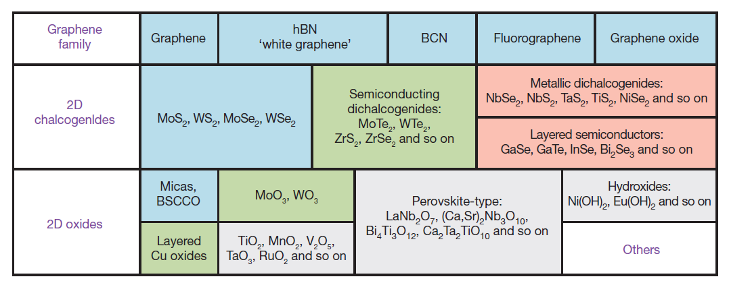
Current 2D library & speculative ideas
Because most of the ‘low-hanging graphene fruits’ have already been harvested, researchers have now started paying more attention to other two-dimensional (2D) atomic crystals6 such as isolated monolayers and few-layer crystals of hexagonal boron nitride (hBN), molybdenum disulphide (MoS2), other dichalcogenides and layered oxides.
Current 2D library. Monolayers proved to be stable under ambient conditions (room temperature in air) are shaded blue; those probably stable in air are shaded green; and those unstable in air but that may be stable in inert atmosphere are shaded pink. Grey shading indicates 3D compounds that have been successfully exfoliated down to monolayers, as is clear from atomic force microscopy, for example, but for which there is little further information. The data given are summarized from refs 6–11, 42 and 55. We note that, after intercalation and exfoliation, the oxides and hydroxides may exhibit stoichiometry different from their 3D parents (for example, TiO2 exfoliates into a stoichiometric monolayer of Ti0.87O2; ref. 8). ‘Others’ indicates that many other 2D crystals—including borides, carbides, nitrides and so on—have probably been7–11 or can be isolated. BCN, boron carbon nitride.
Notes:
Nézzük a papírt!

Slide 5
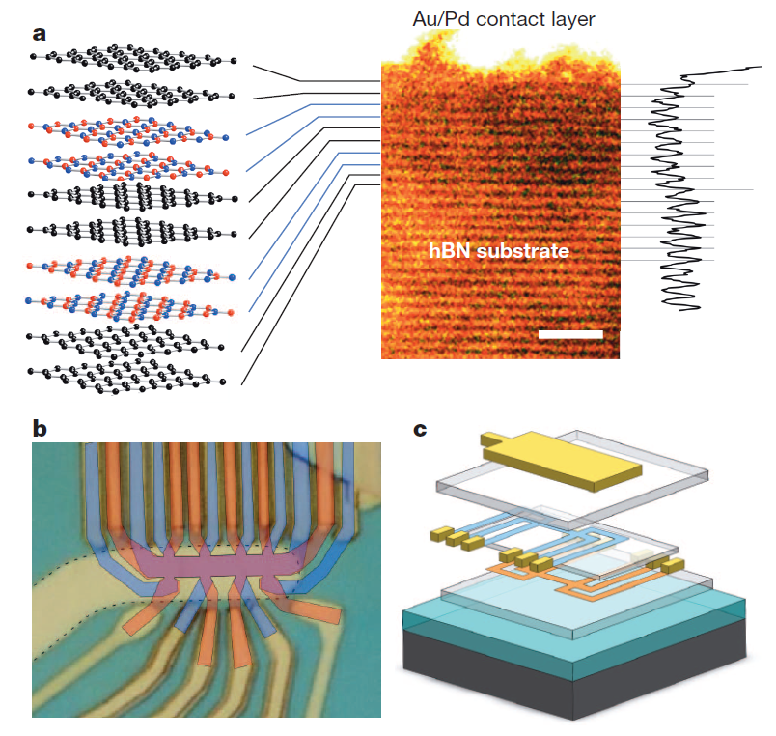
State-of-the-art and future prospects
a, Graphene–hBNsuperlattice consisting of six stacked bilayers. On the right its cross-section and intensity profile as seen by scanning transmission electron microscopy are shown; on the left is a schematic view of the layer sequence. The topmost hBN bilayer is not visible, being merged with the metallic contact. Scale bar, 2 nm. (Adapted from ref. 16.) b, c, Double-layer graphene heterostructures18. An optical image of a working device (b) and its schematics in matching colours (c). Two graphene Hall bars are accurately aligned, separated by a trilayer hBN crystal and encapsulated between relatively thick hBN crystals (hBN is shown in c as semitransparent slabs). The entire heterostructure is placed on top of an oxidized Si wafer (SiO2 is in turquoise). The colours in b indicate the top (blue) and bottom(orange) Hall bars and their overlapping region (violet). The graphene areas are invisible in the final device image because of the top Au gate outlined by dashes. The scale is given by the width of the Hall bars, 1.5 mm.
A few ideas:
Sofisticated multilayer devices
Layer-thick crystals as tunnel barriers: field-effect tunneling transistors
Double-layer graphene devices probing electron-electron interactions
Wigner crystallization, itinerant magnetism, excitonic superfluidity, etc.
Industrial scale: scalable approach needed
problem of epitaxial growing due to island growth
more realistic : growin g individual monolayers on catalytic substrates, then isolating and stacking.
Endless optimism.
Notes:
Industrial!
Cikk papírja: science/ Little evolutionary steps, p4 alja

Slide 6
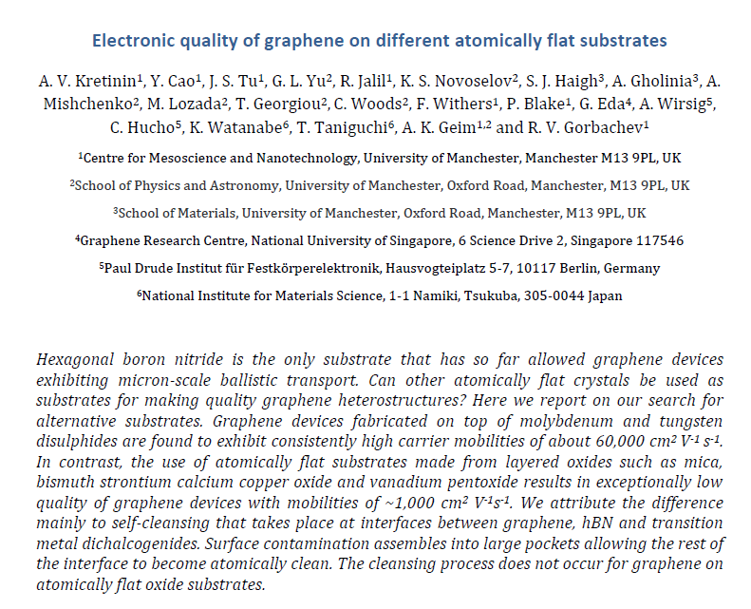
Choice of materials

Slide 7
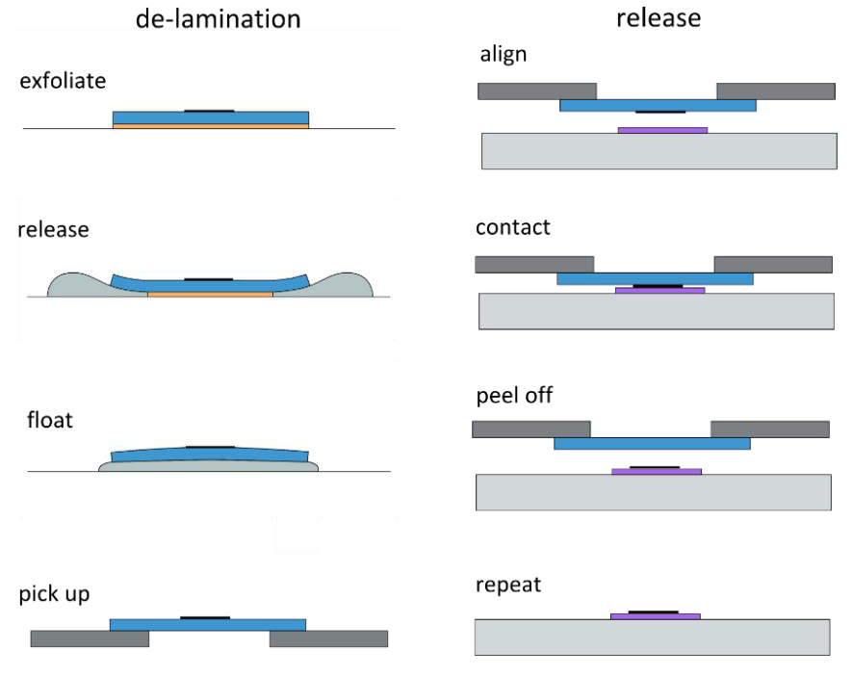
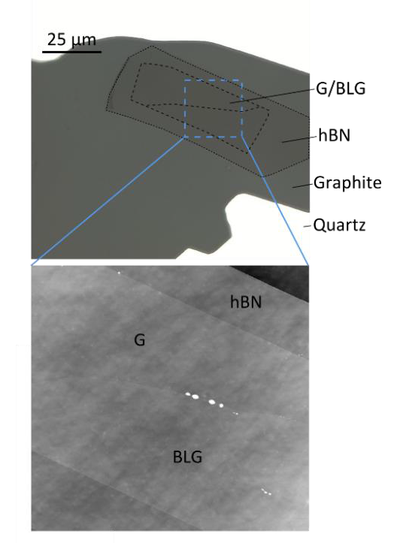
Process
Encapsulated graphene in hBN gives ten times better mobility with respect to ones on SiO2 substrate → FQHE and µm ballistic transport occurs.
Surface flatness is the only critical or other properties are also responsible for this phenomenon? → Investigation of different materials.
Studied materials:
transitional metal dichalcogenides (TMD) such as MoS2 and WS2 and several layered oxides such as muscovite mica, bismuth strontium calcium copper oxide (BSCCO) and vanadium pentoxide (V2O5). As a reference for electronic quality, we use graphene-on-SiO2 and encapsulated graphene-on-hBN hetero-structures.
Dry-peel transfer. Left - Different steps of the transfer procedure. Right - Optical micrograph of non-encapsulated graphene/hBN/graphite heterostructure (top); Zoom-in by using AFM in the tapping mode (bottom).

Slide 8
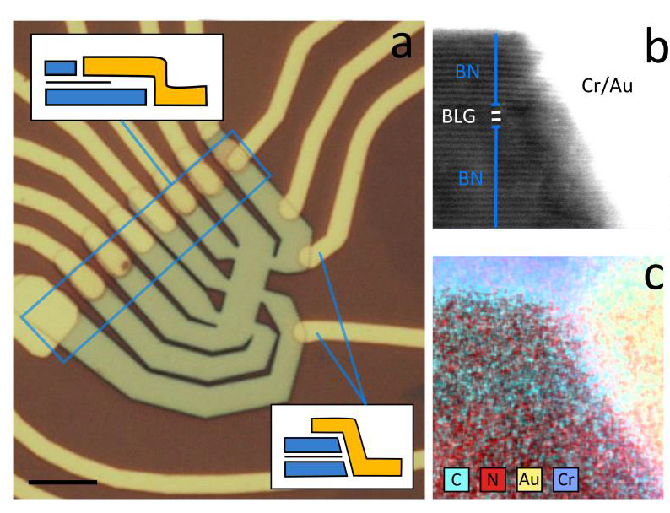
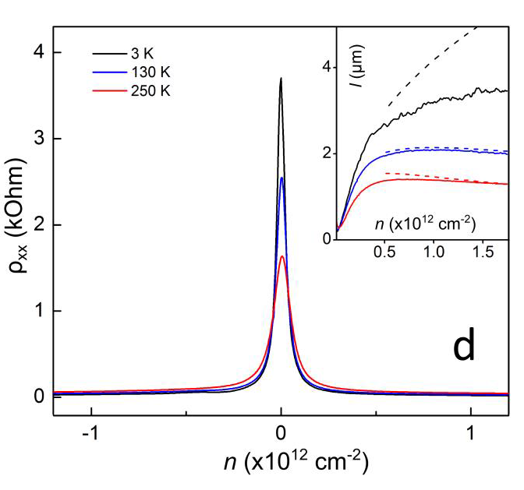
Dominant processes
„Nonetheless, we argue that the crucial role in achieving ultra-high electronic quality is the self-cleansing process previously reported for graphene on hBN11 and now observed for graphene on the disulphides. In this process, van der Waals forces squeeze contamination adsorbed at contacting surfaces into sizeable pockets, leaving the rest of the interface atomically clean. We expect this selfcleansing to occur for all layered TMD.”
Quality of hBN/graphene/hBN eterostructures fabricated by dry peel transfer. (a) Optical micrograph of a Hall bar device with two different types of contacts: overlapping (illustrated by the top inset) and edge (bottom). The scale bar is 5 μm. (b,c) Cross-sectional TEM image of an edge contact to an encapsulated bilayer graphene (BLG) and its HAADF elemental mapping. The images are obtained using thin slices of the contact areas, which were prepared by a focused ion beam.11 The scale is given by the interlayer distance of 3.4 Å.
(d) Resistivity rho_xx and mean free path l (inset) as a function of n at different T for the device in (a). The black dashed line shows l expected if no scattering occurs at device boundaries. Acoustic phonon scattering leads to shorter l at elevated T as shown by the red and blue dashed curves. The theory curves were calculated following refs. 7,12
Notes:
Mu = 500 000 <20K, = 150 000 @RT
Charge inhomogeneity is 10x more than in hBN, 100u2 bubble-free areas

Slide 9
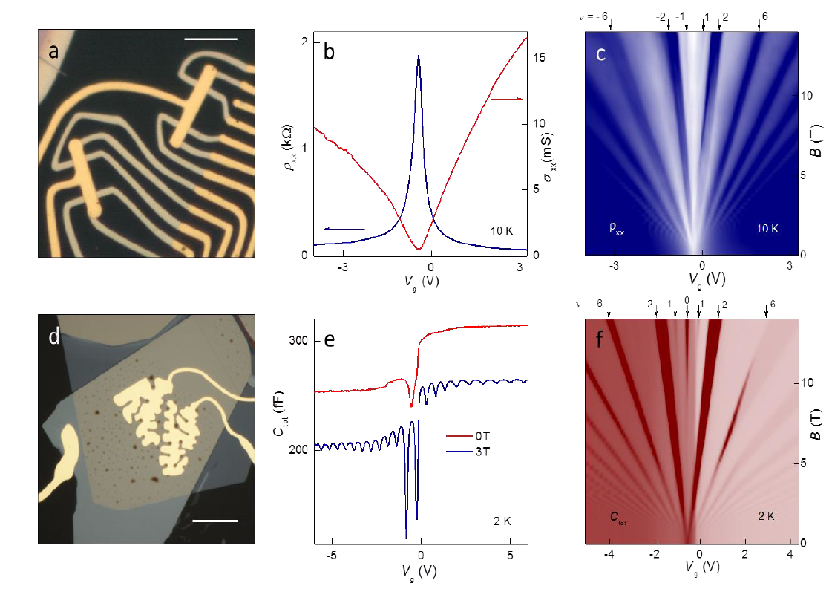
Capacitor devices and Hall bars – MoS2
Graphene devices fabricated on a MoS2 substrate. (a) Optical micrograph of a typical grapheneon-MoS2 Hall bar. The heterostructure is encapsulated with a thin hBN layer that serves as a top gate dielectric. Scale bar, 10 μm. (b) Resistivity and conductivity in zero B for the graphene-on-MoS2 device. (c) Its Landau fan diagram rho_xx(Vg, B). Scale: navy to white, 0 to >3 kOhm. (d) Optical image of a typical graphene-on-MoS2 capacitor. The meandering shape of the top gate is to maximize the active area by avoiding contamination bubbles (dark spots). Scale bar, 15 μm. (e) Capacitance of a graphene-on-MoS2 device in zero and quantizing B. For clarity, the curves are offset by 50 fF. (f) Fan diagram Ctot(Vg, B). Scale: wine to white, 0.18 to 0.3 pF. The numbers and arrows above the plot mark the filling factors, nu .
Notes:
MoS2, WS2: 1.5eV bandgap + doping = nem jó (accu). B, c: mu_fe = 60 000 large angle limited. 8T: felhasasd a spin, SdHO@0.5T--> mu_q=20 000, small-angle sens. Capacitor: no etching or electric contacts.
C,f: asymmetric behaviour: charge induced by Efield into MoS2 (Ds(Vg))

Slide 10
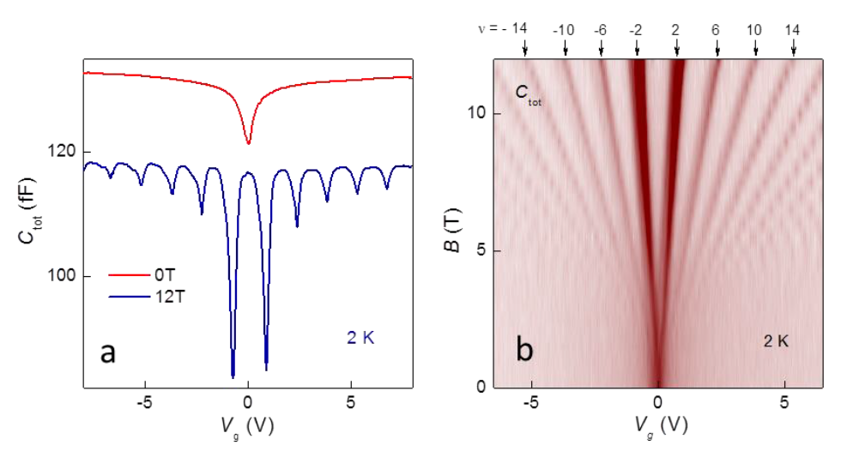
WS2
Capacitance spectroscopy of graphene on WS2. (a) Ctot as a function of Vg in zero and quantizing B. For clarity, the 12T curve is offset by 15 fF. (b) Landau fan diagram Ctot(Vg, B). Scale: wine
to white 0.105 to 0.120 pF.
No asymmetry in Landau fans
No steps in Ctot
Insulating / undpoed crystal – increased Schottky barrier and reduced coupling to graphene.
SOI is present due to heavy atoms (positive magnetoresistance in small B), but no spin-orbit gap - negligible (<20meV even for WS2).

Slide 11
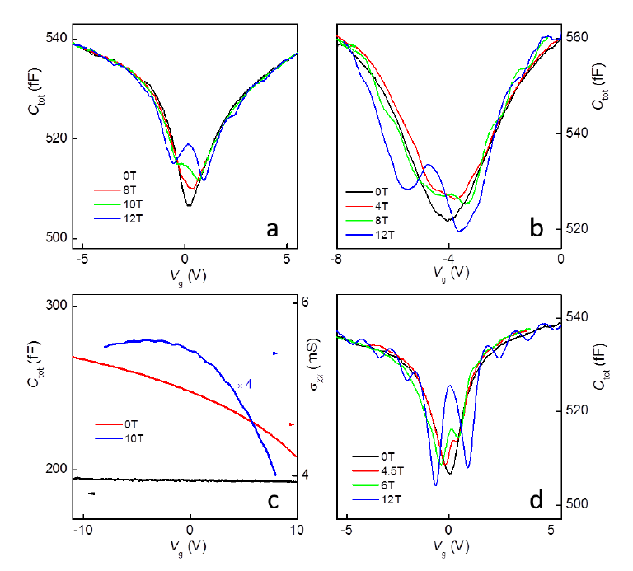
Flat oxides
Capacitance spectroscopy of graphene on various atomically flat oxides at 2 K. (a) Ctot behavior for a graphene-on-mica capacitor in different B. The onset of magneto-oscillations occurs at Bs ~ 10 T. (b) Same for graphene on BSCCO. (c) Capacitance (black curve) and conductivity rho_xx (red and blue) as a function of Vg for graphene-on-V2O5 devices. The high-B curve (blue) is magnified for clarity to reveal magneto-oscillations. The charge neutrality point is shifted to large positive voltages due to heavy doping by the substrate. (d) Ctot for graphene on atomically rough LiNbO3. The onset of magneto-oscillations occurs at Bs ~ 4 T.
Notes:
Mu ~ 1e3. Hidrofil- hidrofób!

Slide 12
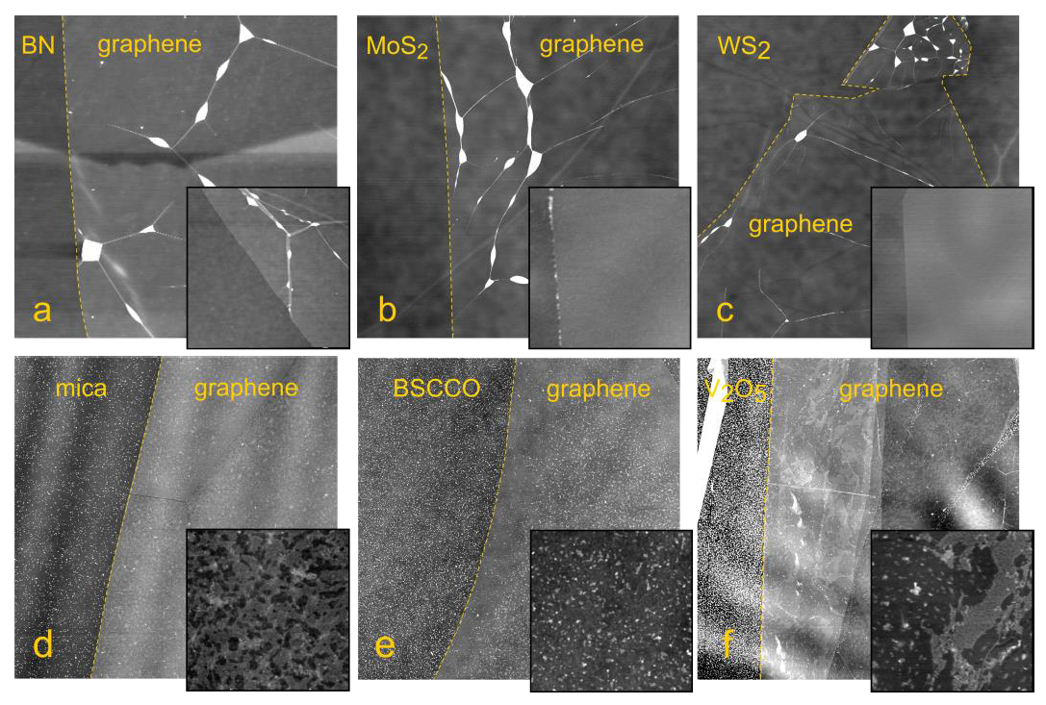
Surfaces of different layers
AFM topology of graphene on various substrates. (a-f) Graphene on hBN, MoS2, WS2, mica, BSCCO and V2O5. All scan sizes: 15 μm × 15 μm. Scale: black to white, 5.5 nm. The yellow dashed curves highlight edges of graphene flakes. Insets: 1.5 μm × 1.5 μm; black to white, 4 nm. Due to self-cleansing for graphene on hBN, MoS2 and WS2, hydrocarbon contamination is aggregated into bubbles seen in (a-c) as bright spots connected by graphene wrinkles. The submicron-scale structures seen in the insets for (d,f) are probably due to a few monolayers of captured water.14-16 The small bright dots in (d-f) are a residue that is due to the use of acetone to dissolve PMMA at the final stage and is not at the graphene interface.
Notes:
Papíron! Doping.
No dry-peel transfer! Weaker adhesion due to intercalating water.
300K annealing – higher wuality expected but above 150 it degrades.

Slide 13
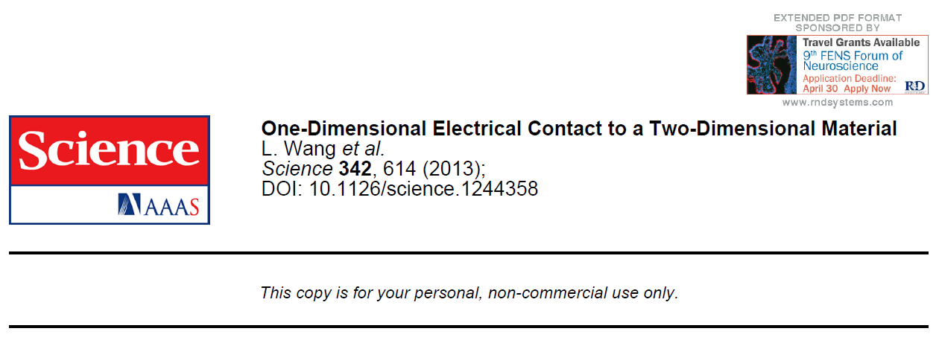
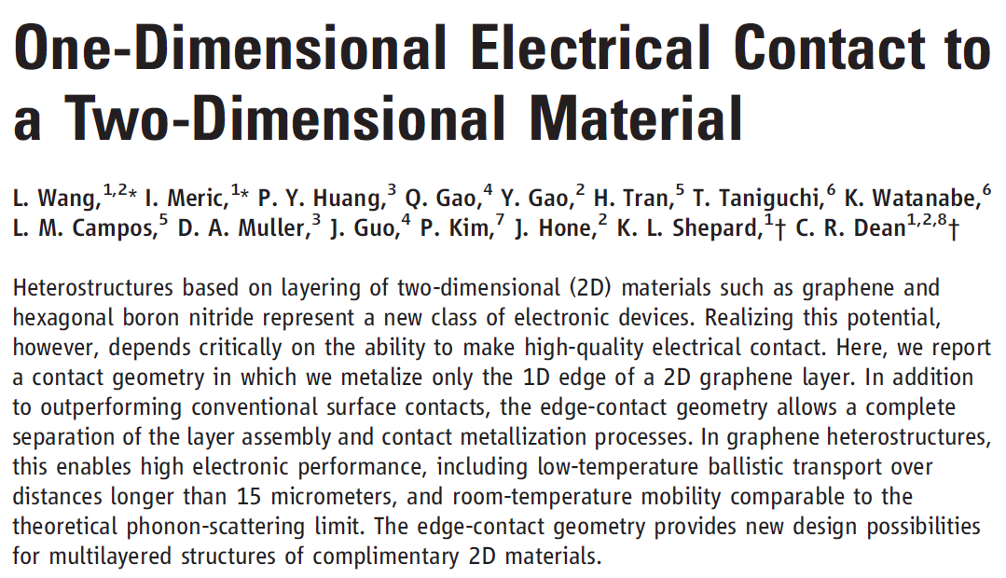

Slide 14
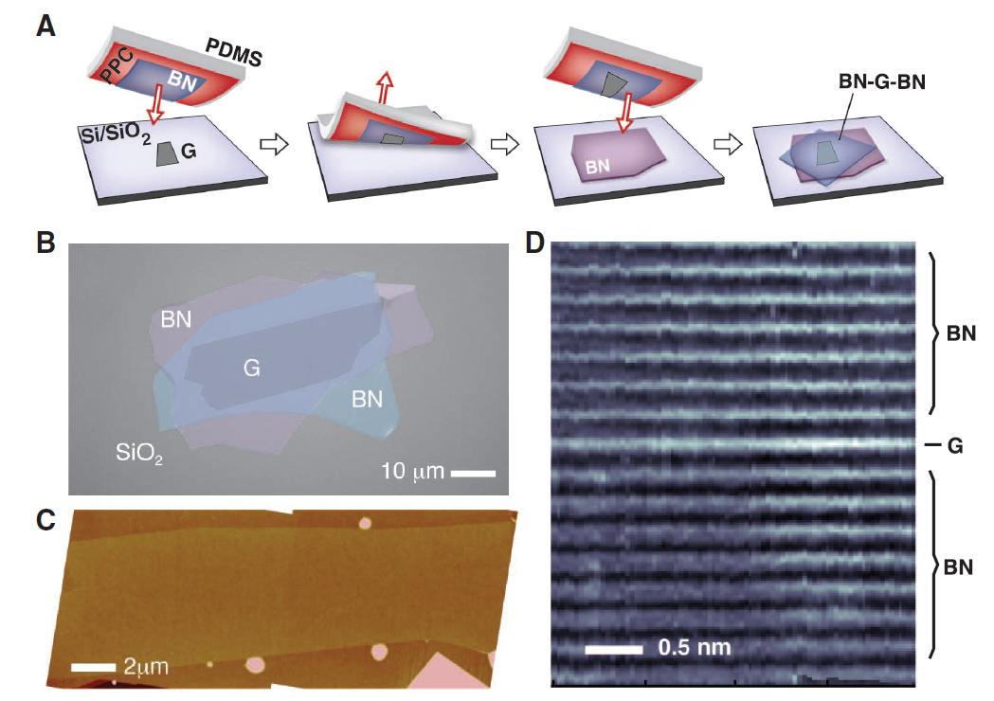
hBN-G-hBN polymer-free layer assembly
(A) Schematic of the van der Waals technique for polymer-free assembly of layered materials. (B) Optical image of a multilayered heterostructure using the process illustrated in (A). (C) AFM image of a large-area encapsulated graphene layer showing that it is pristine and completely free of wrinkles or bubbles except at its boundary. (D) High-resolution cross-section ADF-STEM image of the device in (C). The BN-G-BN interface is found to be pristine and free of any impurities down to the atomic scale.

Slide 15
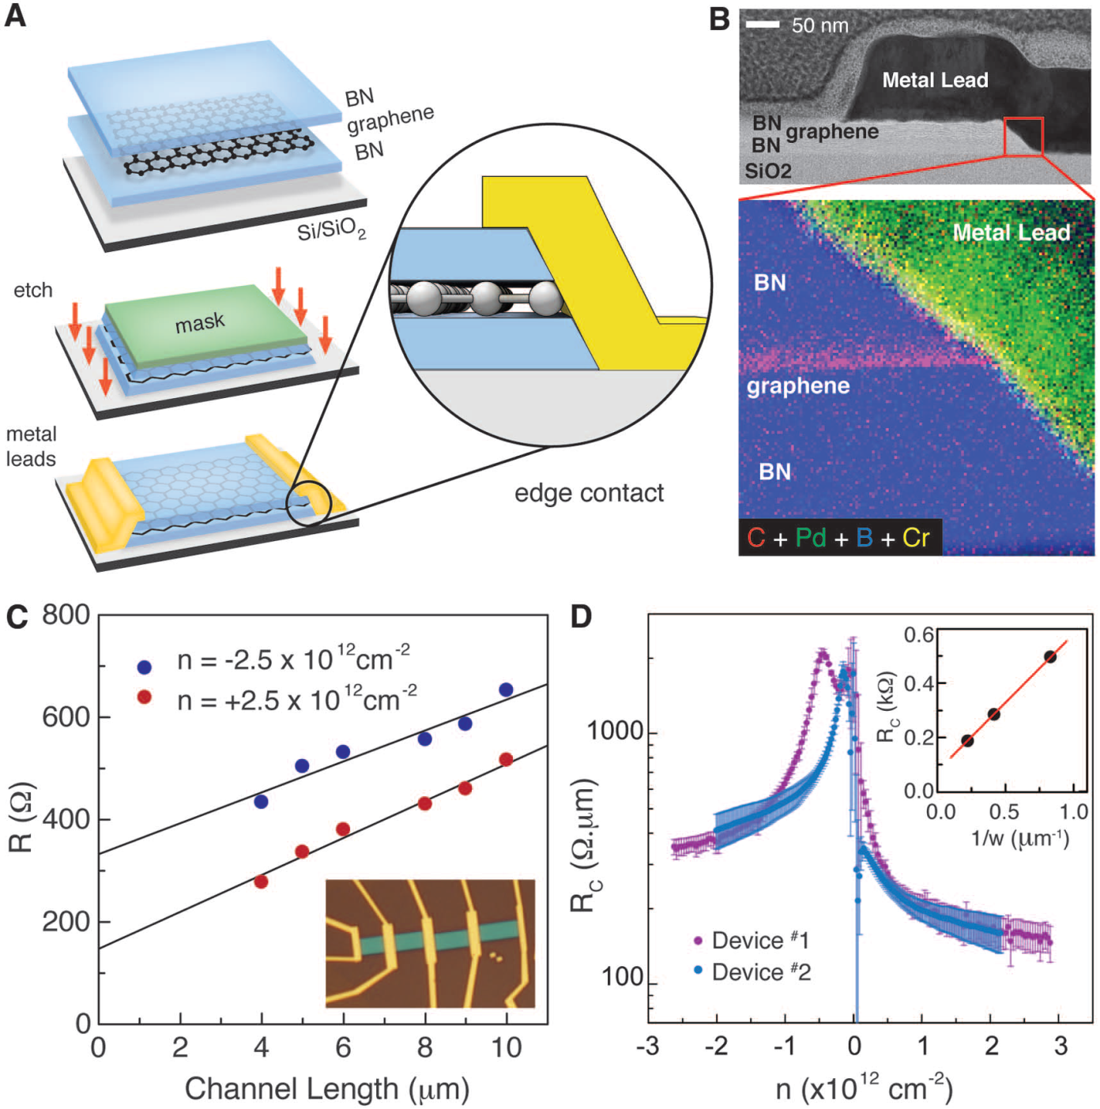
Edge-contact
(A) Schematic of the edgecontact fabrication process. (B) High-resolution bright-field STEM image showing details of the edgecontact geometry. The expanded region shows a magnified false-color EELS map (fig. S6) of the interface between the graphene edge and metal lead. (C) Two-terminal resistance versus channel length at fixed density, measured from a single graphene device in the TLM geometry. Solid line is a linear fit to the data. Inset shows an optical image of a TLM device with edge-contacts. (D) Contact resistance calculated from the linear fit at multiple carrier densities for two separate devices. Error bars represent uncertainty in the fitting. Inset shows resistance scaling with contact width measured from a separate device.

Slide 16
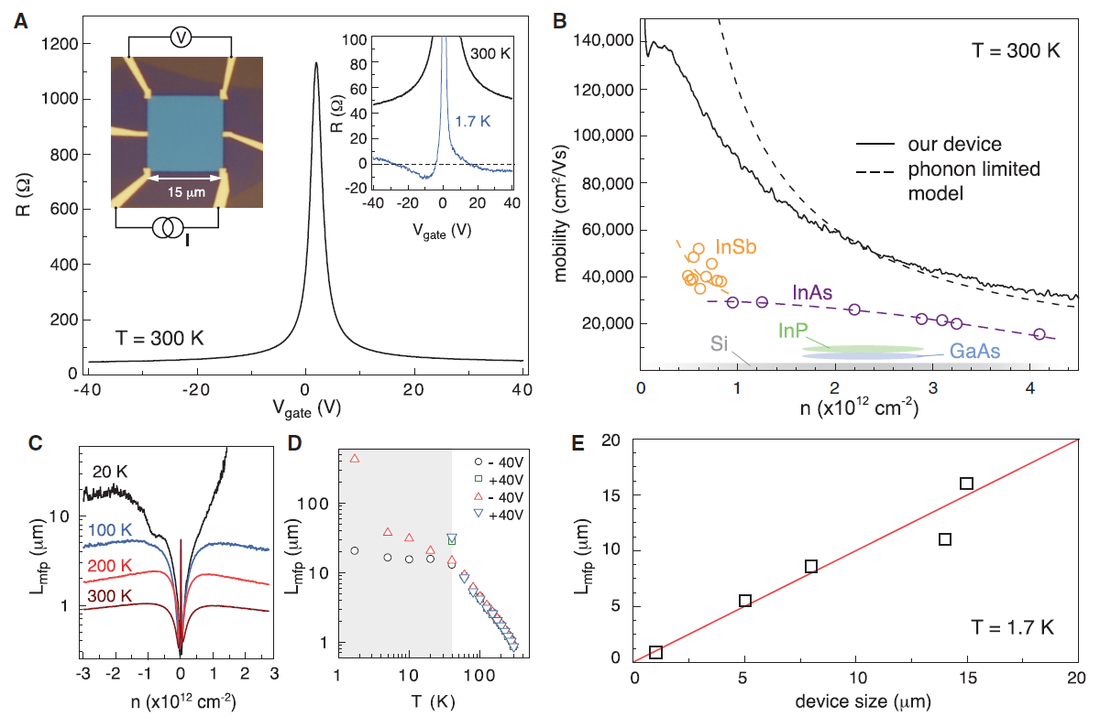
Large-area, high-performance, BN-G-BN devices.
(A) Fourterminal resistivity measured from a 15 mm × 15 mm device fabricated by the van der Waals assembly technique with edge-contacts. The left inset shows an optical image of the device. Low-temperature response is shown in the right inset. A negative resistance is observed, indicating ballistic transport. (B) Room-temperature mobility versus density (solid black curve). Dashed black curve indicates the theoretical mobility limit due to acoustic-phonon scattering (28, 29). Remaining data points label the range of mobilities reported in the literature for high-performance 2D semiconductor FETs (30, 31). (C and D) Calculated mean free path versus density and temperature for the device shown in (A). Shaded region in (D) indicates the temperature below which the mean free path exceeds the device size. Circle and squares correspond to the “a” configuration and triangles correspond to the “b” configuration of the van der Pauw measurement (supplementary materials section 1.5). (E) Lower bound mean free path at T = 1.7 K for devices with size varying from 1 to 15 mm.

