Slide 1
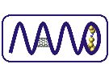
Electrical control over single hole spins in nanowire quantum dots
V. S. Pribiag, S. Nadj-Perge, S. M. Frolov, J. W. G. van den Berg, I. van Weperen, S. R. Plissard, E. P. A. M. Bakkers and L. P. Kouwenhoven
arXiv:1302.2648
Gergő
NanoJC
22/02/2013

Slide 2
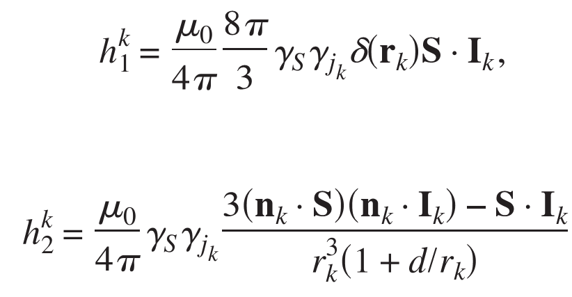
Outline
Holes in III-V semiconductors
strong spin-orbit interaction
different effective mass
weak coupling to nuclear spins → longer coherence times
holes with p-orbitals: contact hyperfine interaction vanishes
(10.1103/PhysRevB.78.155329)
Hole quantum dots
fabrication is challenging
conventional p-doped quantum wells: low stability and tuneability
InSb nanowire: high stability&tuneability → direct comparison of electrons and holes

Slide 3
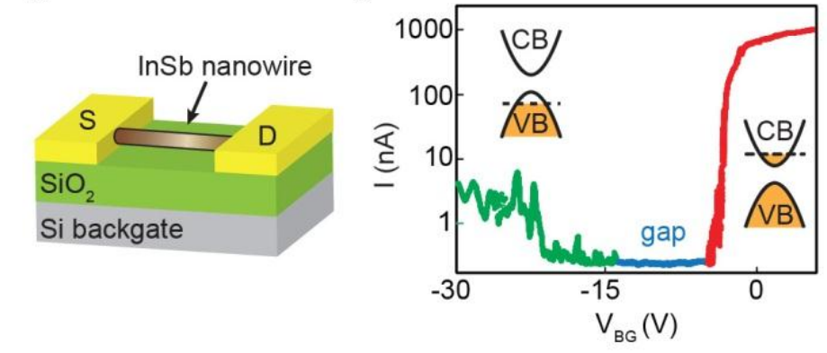
Basic device
InSb nanowire
precise control over crystal structure
small bandgap (≈0.2 eV)
100 nm in diameter, 2-3 μm long
Basic device
demonstration of ambipolar transport
285 nm SiO₂, Ti/Au contacts, 300 nm spacing
300 mK base temperature

Slide 4
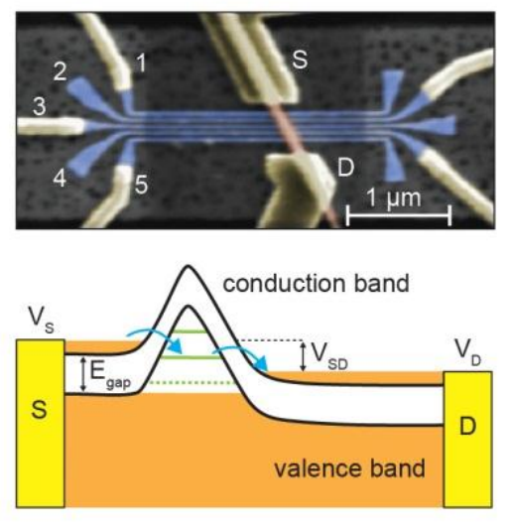
Defining quantum dots
Device with finger gates
Ti/Al contacts
InSb nanowire
25 nm Si₃N₄
finger gates (gate widths&inter-gate spacing ≈30 nm)
50 nm Si₃N₄
wide gate

Slide 5
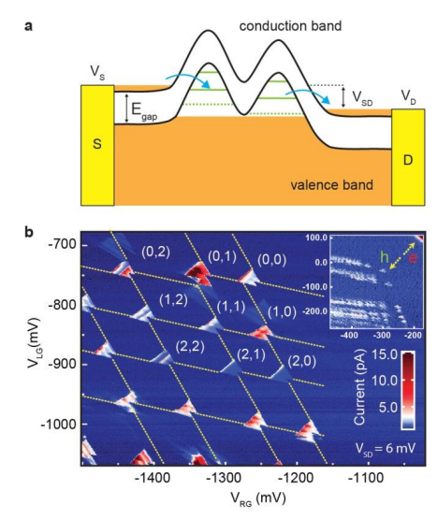
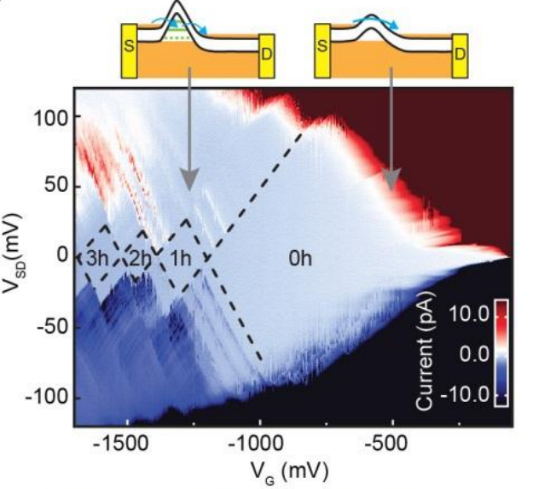
Defining quantum dots
Confining potential
Single dot:
negative voltage on a single gate
npn-like NW
Double dot
using gates 2&3 → strong interdot coupling using gates 2&4 → weak interdot coupling
nppn-like NW

Slide 6
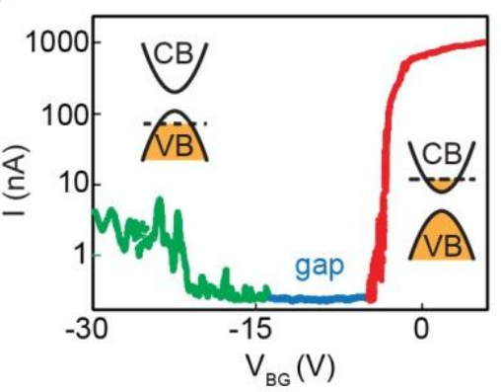
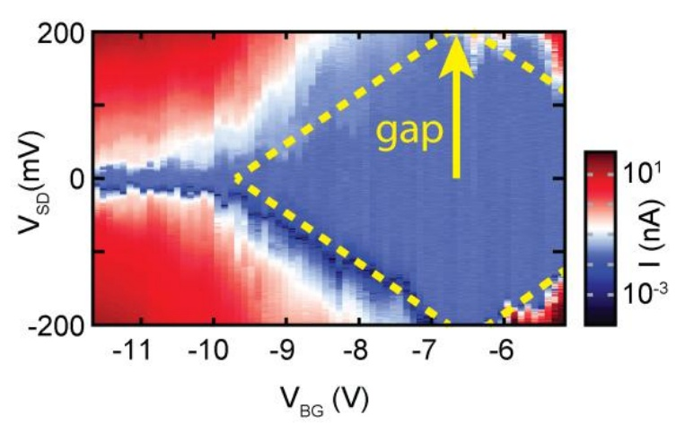
Measurements on the basic device
Determination of the bandgap
large bias stability diagram of the basic device
bandgap ≈ 0.2 eV

Slide 7
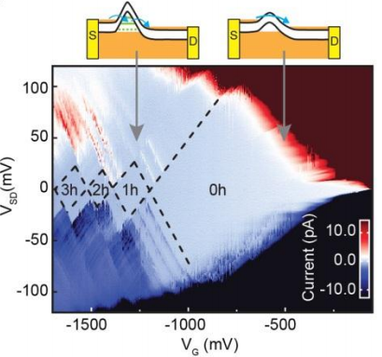
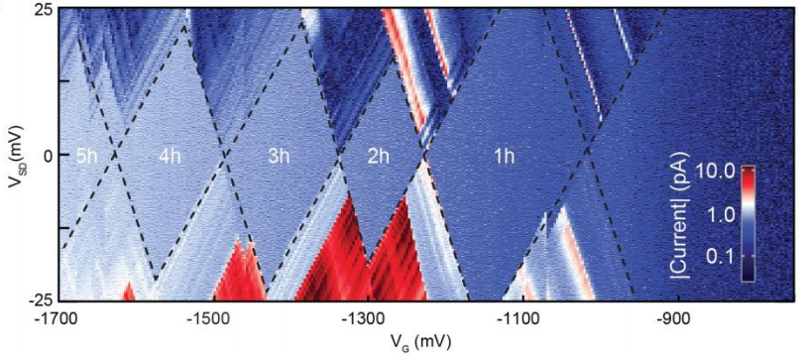
Single dot measurements
Stability diagram
few hole regime
direct tunneling in the conduction band over V_{sd}≈90 mV

Slide 8
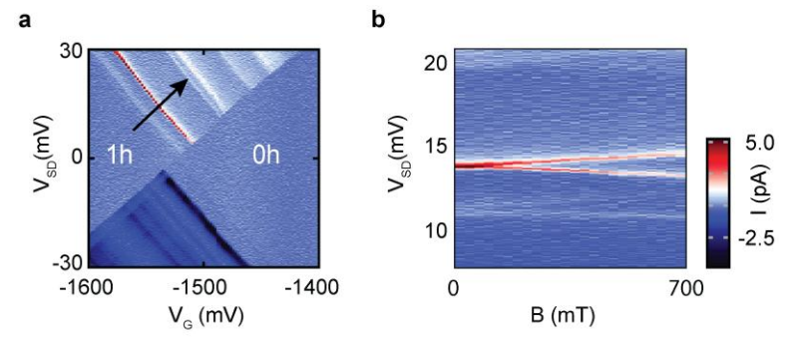
Single dot measurements
Stability diagram
resonances ending at the 0h diamond?
g-factor≈35 → electrons → DOS of the n-type leads

Slide 9
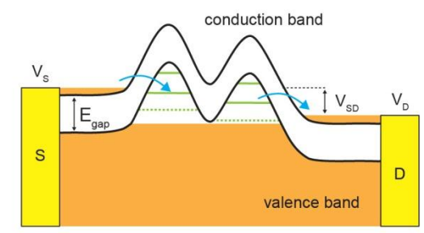
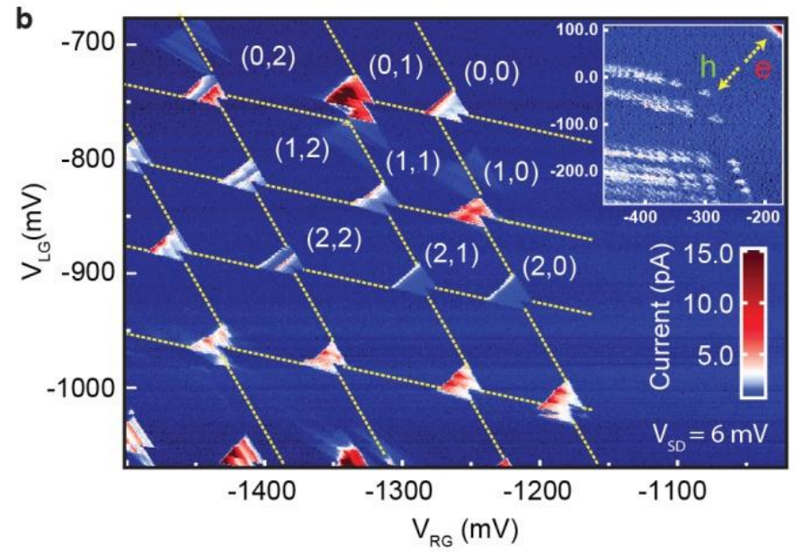
Double dot measurements
Few-hole double dot

Slide 10
Double dot measurements
g-factor measurements
Pauli spin blockade
lifted by EDSR
cross section at f=3.4 GHz
2-axis vector magnet → investigation of anisotropy

Slide 11
Double dot measurements
g-factor measurements
electron g-factor ≈35-45
hole g-factor ≈0.5-4
→ gate-induced g-tensor modulation also contributes to the EDSR mechanism (apart from the direct SOI)

Slide 12
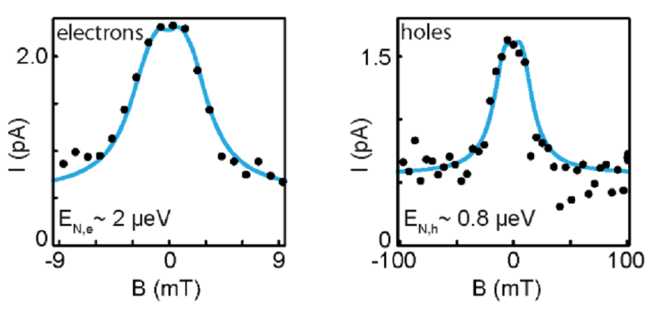
Double dot measurements
g-factor measurements
peak at B=0 due to hyperfine interaction → A_{e}/A_{h}≈7

Slide 13
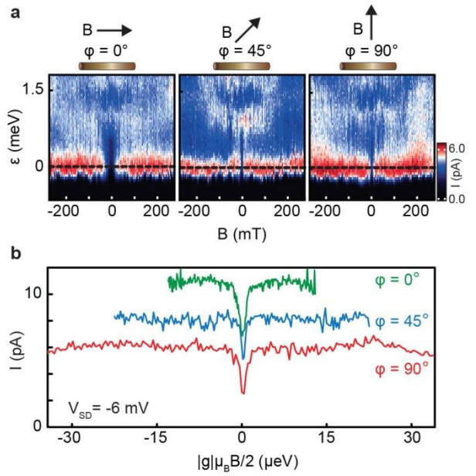
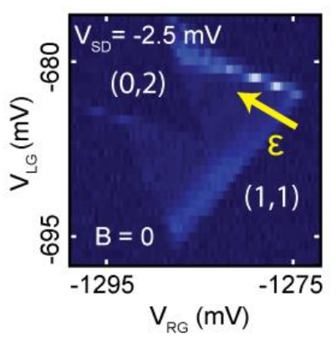
Double dot measurements
strong interdot coupling regime
spin blockade lifted by finite B → dip at B=0
for electrons: mixing of states by SOI → anisotropic
for holes, it's isotropic!

Slide 14
The end
Thank you for your attention!

