Slide 1
Superconductivity, Nanowires, Quantum Dots, Cooper-pairs, Majoranna-fermions alias 3 more JCs
Zoltán Scherübl
24.10.2013
BME Nanophysics Seminar - Lecture

Slide 2
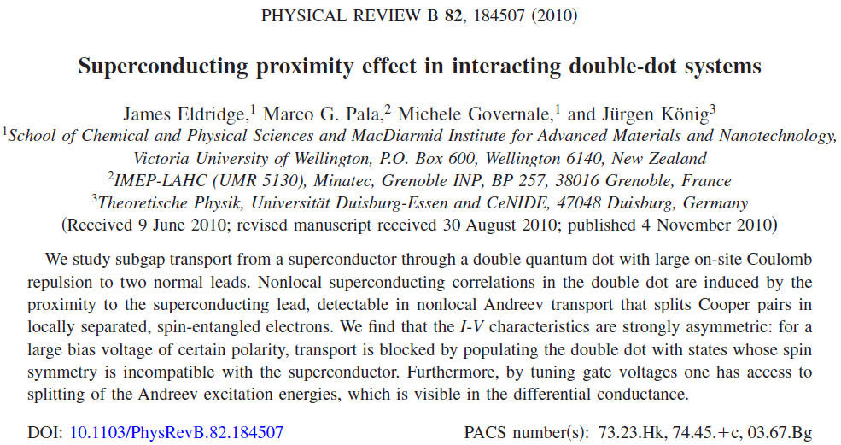

Slide 3
The Hamiltonian:
$$H_{ddot}=\sum_{α=L,R}{\left[ε_{α}\sum_{σ}{d_{ασ}^{+}d_{ασ}+U_{α}n_{α↑}n_{α↓}}\right]+U\sum_{σ,σ′}{n_{Lσ}n_{Rσ′}}}$$
$$H_{η}=\sum_{kσ}{ε_{ηk}c_{ηkσ}^{+}c_{ηkσ}−δ_{η,S}∆\sum_{k}{\left(c_{η−k↓}c_{ηk↑}+h.c.\right)}}$$
$$H_{tunn,N}=\sum_{αkσ}{\left[V_{Nα}c_{αkσ}^{+}d_{ασ}+h.c.\right]}$$
Constant DOS assumed: ρ_{η}
Tunnel-couplings:
$$∆∈R,∆>0$$
$$Γ_{Nα}=2πρ_{α}{\left|V_{Nα}\right|}^{2}$$
$$μ_{S}=0$$
$$Γ_{Sα}=2πρ_{S}{\left|V_{Sα}\right|}^{2}$$
$$H_{tunn,S}=\sum_{αkσ}{\left[V_{Sα}c_{Skσ}^{+}d_{ασ}+h.c.\right]}$$
Δ→∞ limit: no quasiparticles
$$H_{eff}=H_{ddot}−\sum_{α=L,R}{\frac{Γ_{Sα}}{2}\left(d_{α↑}^{+}d_{α↓}^{+}+h.c.\right)}+\frac{\sqrt{Γ_{SL}Γ_{SR}}}{2}\left(d_{R↑}^{+}d_{L↓}^{+}−d_{R↓}^{+}d_{L↑}^{+}+h.c.\right)$$
U_{α}→∞ limit: 0 or 1 e / dot, local Andreev process is forbidden
9 basis states:
$$|\left.0\right\rangle$$
$$|\left.T0\right\rangle =\frac{1}{\sqrt{2}}\left(d_{R↑}^{+}d_{L↓}^{+}+d_{R↓}^{+}d_{L↑}^{+}\right)|\left.0\right\rangle$$
$$|\left.ασ\right\rangle =d_{ασ}^{+}|\left.0\right\rangle$$
$$|\left.S\right\rangle =\frac{1}{\sqrt{2}}\left(d_{R↑}^{+}d_{L↓}^{+}−d_{R↓}^{+}d_{L↑}^{+}\right)|\left.0\right\rangle$$
$$|\left.Tσ\right\rangle =d_{Rσ}^{+}d_{Lσ}^{+}|\left.0\right\rangle$$

Slide 4
In this limit only |0> and |S> are coupled:
Andreev-excitations: excitation of DQD w/o coupling to normal leads:
Calculation of current (master-equation):
Normal leads are integrated out → reduced density-matrix
→ first order tunneling process → reduced density matrix is diagonal
Master-equation: Fermi’s golden rule transition rate
Occupation probability
Zeroth order spectral function: delta-peaks at Andreev-excitaion energies
Broadening due to Γ_{N}: second order → not discussed
Current:

Slide 5
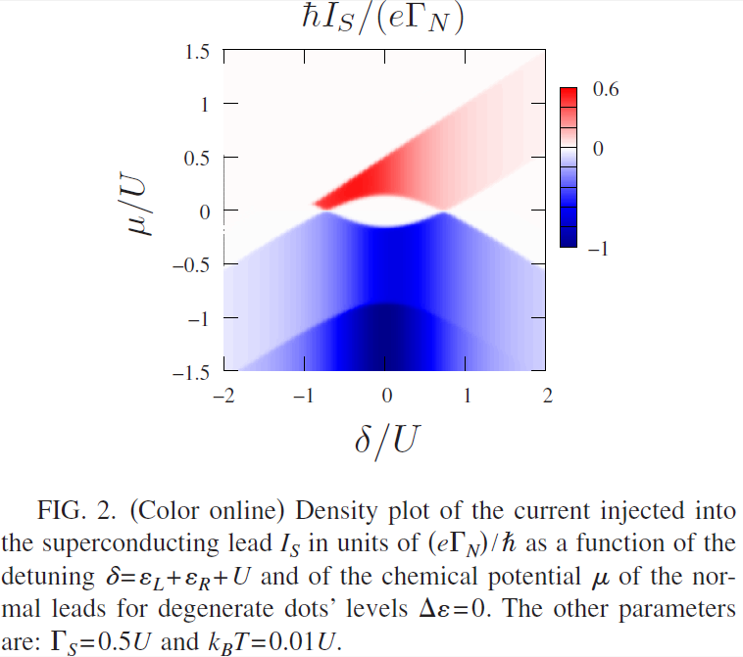
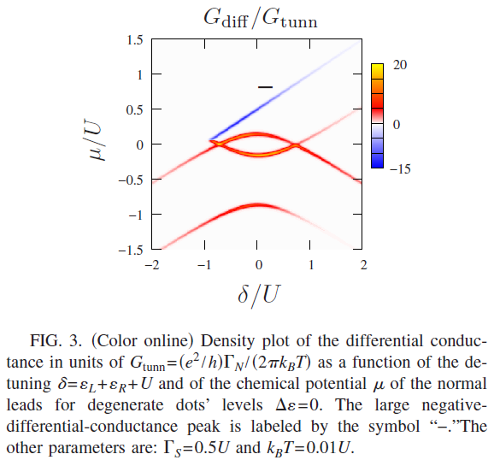
Results:
Triplett-blockade:
Asymmetric current in bias voltage
Cooper-pairs can split to the dots, and tunnel into the normal leads
Reverse: if the dot is occupied with triplett electrons, the current is blocked
Differential conductance:

Slide 6
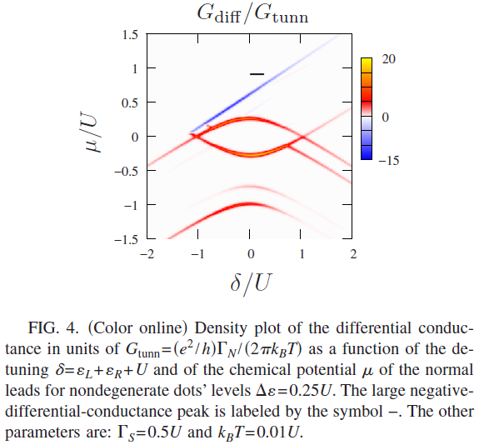
Andreev excitation energy splitting:
Non degenerate dot levels (Δε≠0)
Although left-right symmetry is broken, I_{L} = I_{R}
In first order only CAR is allowed

Slide 7
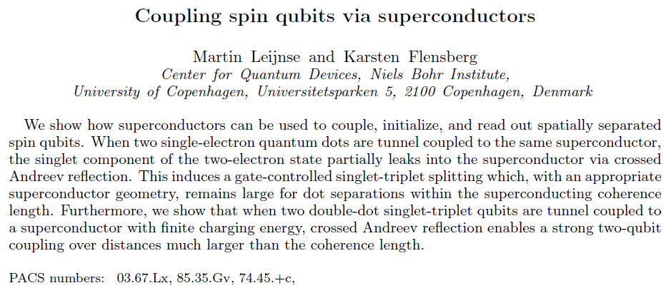

Slide 8
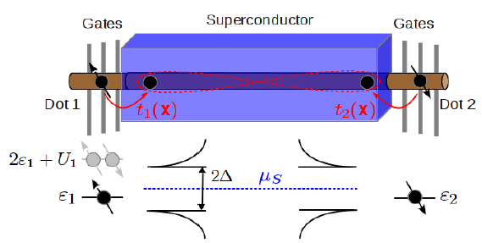
Coupling two dots:
Energy shifts due to SC in (1,1) regime:
Second order term are equal → neglected
Fourth order:
Two processes lowers the S energy:
1. Exchange: electron tunnel to the other dot, and backwards ((0,2) intermediate state)
2. CAR: 2 electron tunnel from the dots to SC, and backwards ((0,0) intermediate state)
B_{i} =0 →
Analyitic solution:
At 3D, ballistic SC:
At 3D: diffusive SC: slighty better prefactor: but ξ₀ →
Problem: summing for different paths with different factor
Prefactor → ~Å interaction length

Slide 9
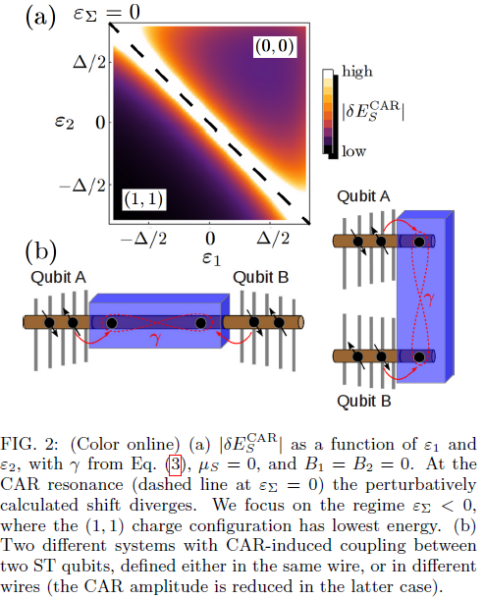
In 1D single channel, ballistic SC:
Interaction length:
1. Exchange:
Since U is large, exchange is neglected
Effect of SOI: w/o B only 1 of 4 (1,1) state couples to S
Effect of B&SOI: 2 split off states have finite CAR (T+,T-)
1 state has no CAR (T0)
1 state has CAR amplitude (S)
Operation:
Initialization: adiabatic sweep from (0,0) to (1,1)
Tuning the dot levels or tunnel couplings
Avoid decoherence due to charge noise: far from
Readout : sweep from (1,1) to (0,0) – triplett blockade
Up to now:
Coupling 2 single-spin qubit (δE_{S} acts as a 2-qubit gate)
Non-local S-T qubit
Coupling S-T qubits (Fig. 2(b))

Slide 10
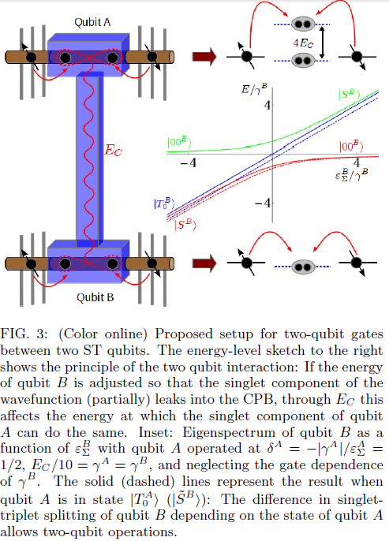
Hamiltonian of 1 S-T qubit (coupled to SC):
Cooper-pair box: finite charging energy (E_{C}), fix electron number (N)
2 S-T qubit coulped to a long ( >> ξ₀ ) CPB: capacitive coupling
|00> is not part of S-T qubit base, but:
Numbers:
→
→
V_{AB} saturates with E_{C} for fixed γ,δ
Large V_{AB} with small δ requires large γ
(few channel NW high quality interface)

Slide 11
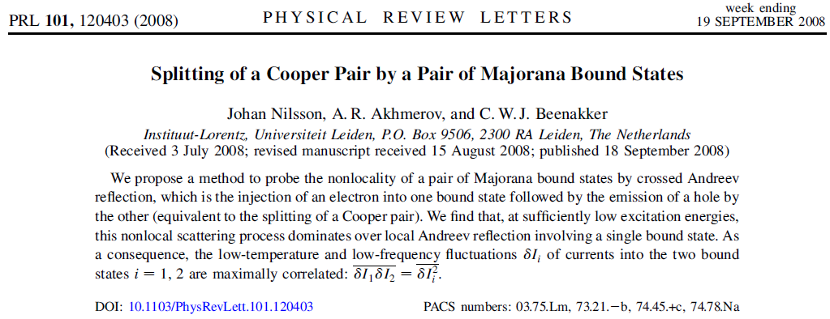
Majorana bound state suppress LAR in favor of CAR

Slide 12
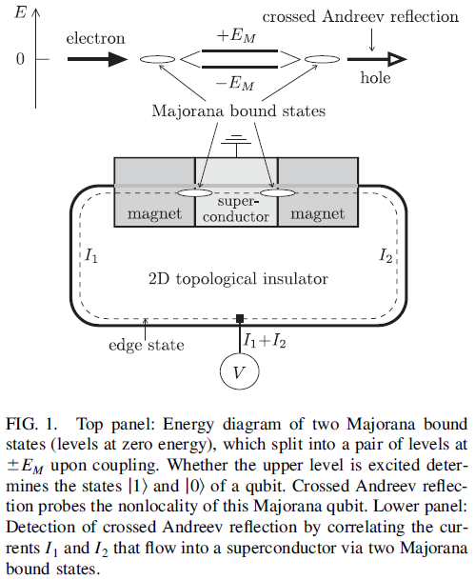
Majorana Hamiltonian:
Excitation energy: E
Level width: Γ_{M}
<< E_{M} needed for suppression of LAR
Unitary scattering matrix:
Basis: propagating
electrones and holes in leads
Assumptions: no cross-coupling,
energy dependence neglected
2 MBSs
Low excitation energy, weak coupling:
Off-diag of S: only off-diag element: only CAR (or normal tunneling) with probability
Probability of LAR:

Slide 13
Probability of e₁ → e₂ and e₁ → h₂ equal → CAR cannot be detected in the current → noise:
Assumption: equally baised leads, low temperature ( ), weak coupling ( )
→ Shot-noise dominates → transfered charge from Fano-factor ( )
Some nice formulas:
Zero-frequency noise power:
Low energy weak coupling limit:
Total noise: → Cooper-pair transfer
Separate leads: → suppression of LAR
The positive cross-correlation is maximal, since (here =)
Note: high voltage regime: (time is not enough for correlations to develop)

Slide 14
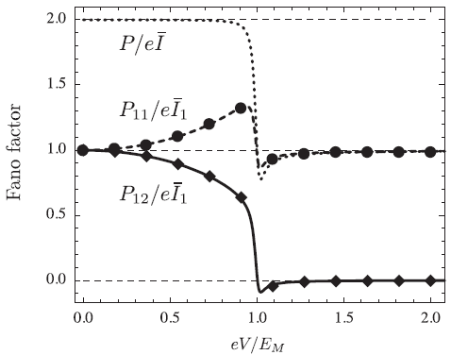
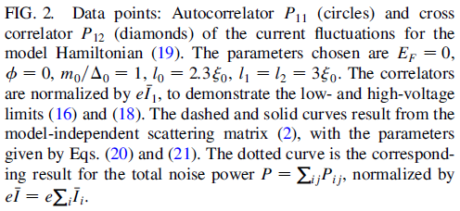
Exactly solvable model: 2D TI, with SC and 2 magnet
$$∆\left(x\right)=\left\{\begin{matrix}∆_{0} & 0<x<l_{0} \\ 0 & \end{matrix}\right.$$
$$m=\left\{\begin{matrix}\left(m_{0},0,0\right) & −l_{1}<x<0 \\ \left(m_{0}sinφ,m_{0}sinφ,0\right) & l_{0}<x<l_{0}+l_{2} \\ 0 & \end{matrix}\right.$$
Fermi level within the gap:
Decay length in SC:
in magnet:
For only bound state is MBS
For and

