Slide 1
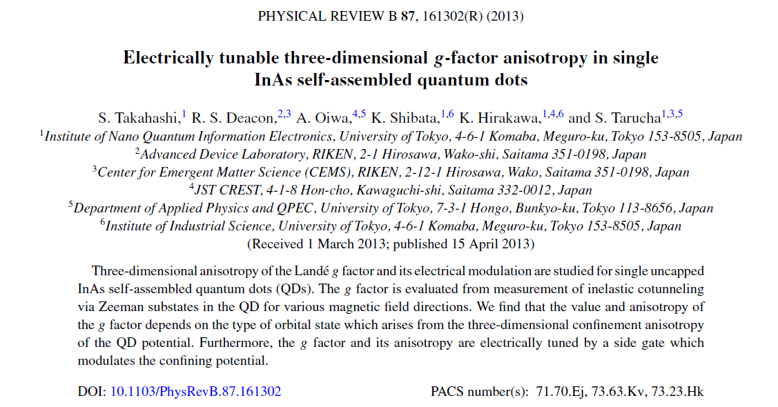
Nanoseminar JC
FÜLÖP Bálint
2013.04.26.

Slide 2
Introduction : Landé g-factor
Landé factor is determined by the coupling between the orbital and spin angular momenta
It reflects the spin-orbit interaction and the quantum confinement.

Slide 3
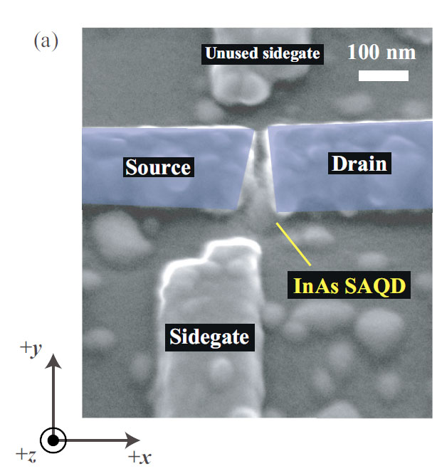
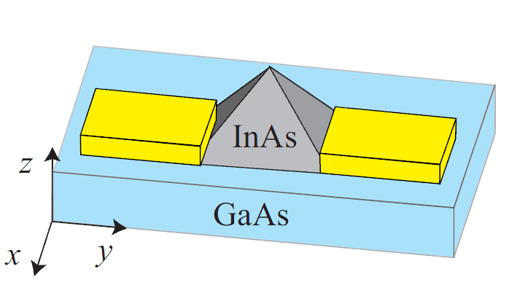
Measured systems
Lithographed self-assembled QD’s
Strong out-of-plane and weak in-plane confinement
2D calculations based on disk-like QD conception
Studies of SOI anisotropy: 3D confinement more realistic
Arbitrary direction of orbital angular momentum

Slide 4
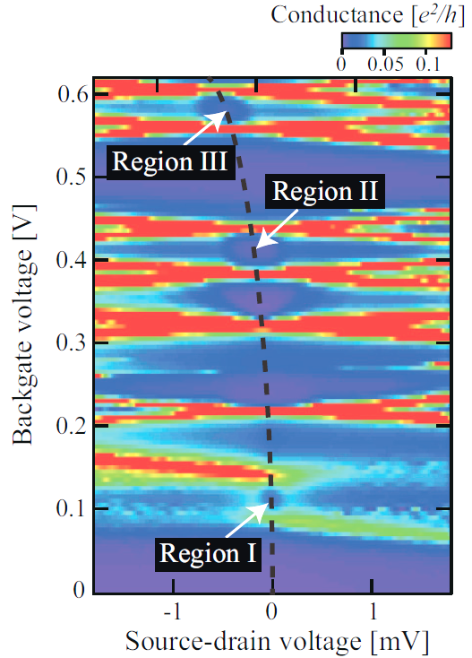
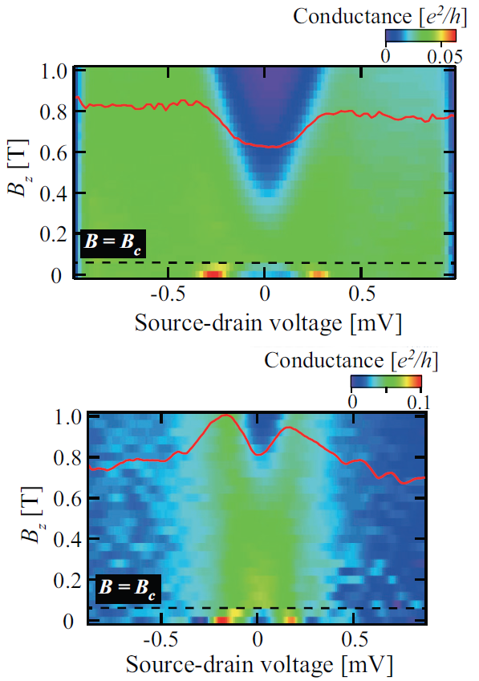
Stability diagram
B = 1T, Vsg = 0V, 40mK
Shift in zero bias line
3 different regions
Inelastic cotunneling or Kondo effect

Slide 5
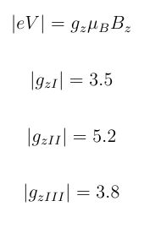
Magnetic evolution of the regions
Peak width ➔ T = 1K
Note: Al is in SC state under Bc=100mT

Slide 6
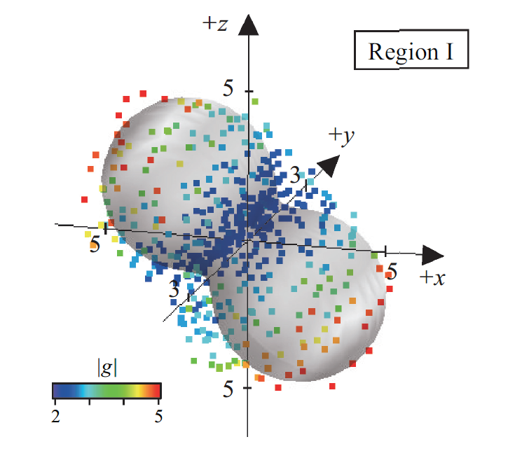
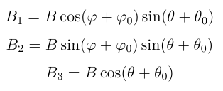
Anisotropy of the g-factor
1T B-field in various directions
Colors: values of the g-factor
Gray spheres: theoretical fit to the data
General model for fitting

Slide 7
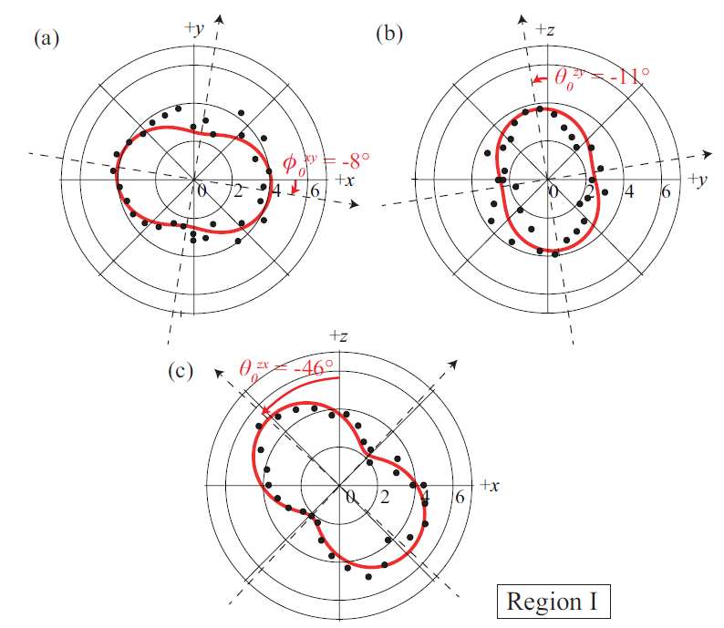
Cut planes of the Region I polar plot

Slide 8
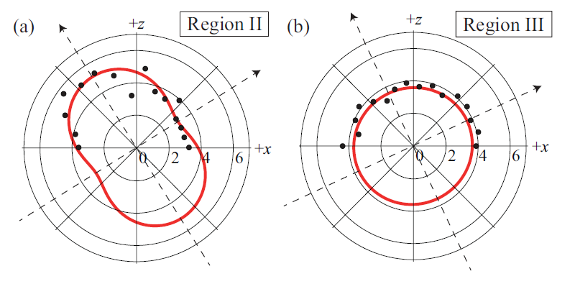
Regions II & III
8-band kp-model
asymmetry in potential
45º tilted planar p-orbital states
in-plane magnetic effect of Coulomb-peaks were studied
Zeeman and OAM effects are involved

Slide 9
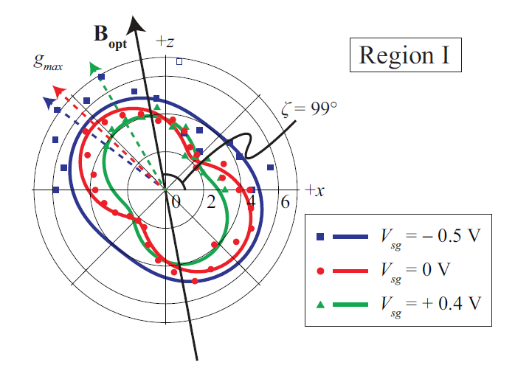
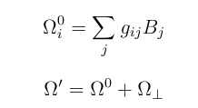
Effect of the side gate
Rabi frequency of electron spin by means of g-TMR
Spin precession vector
The perpendicular component is biggest if B||B₀
20GHz Larmor frequency and 1mV MW-induced ac voltage leads to 0.88MHz (consistent with other experiments)

